Slide 1
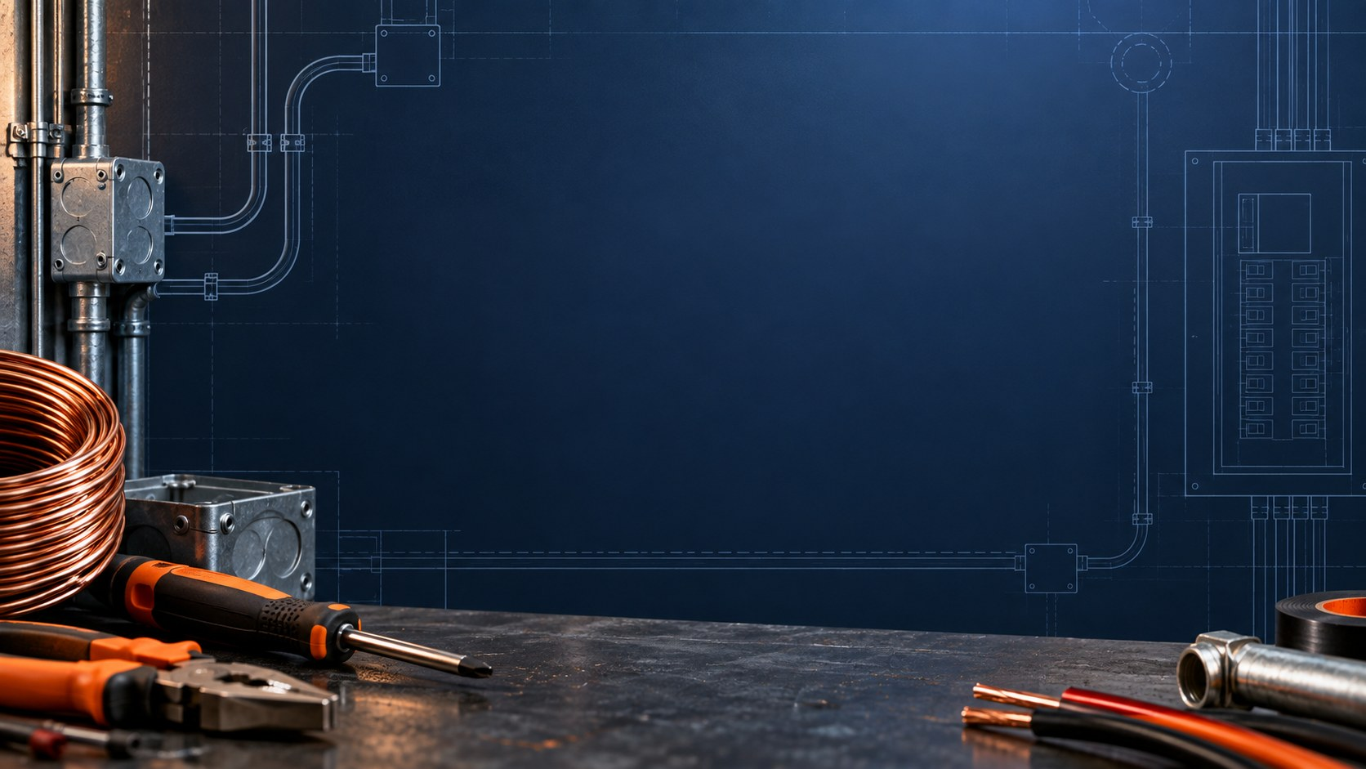
LAB 1 STEP 1 OF 5 SCHEMATIC FIRST
1 / 27
Three parallel branches
YOUR STATION
3 V (2×AAA) pack, three 220 Ω resistors, board, meter, jumpers and paper.
UNPOWERED CHECK
+
Check board continuity and each isolated resistor in Ω. Record R1–R3.
B1
3 V
2×AAA
R1
220 Ω
R2
220 Ω
R3
220 Ω
−
SCHEMATIC BUILD
Connect each resistor between the same positive and negative source nodes.
Schematic first. Try the connections before opening the next breadboard view.
CHECK
Build with the pack disconnected. Try the schematic before viewing the next slide.
DC Theory Chapter 5 Student labs 3 V pack (2×AAA) Slide 1 of 27
Notes:
Record predictions, readings with units and explanations on paper. Follow your actual meter input and range labels. Disconnect before wire or lead changes.
Source: NJATC DC Theory, 3rd edition, ISBN 9781935941125, Chapter 5, printed pp. 114–115. Book figures cropped from supplied Ch05DCTheory photos. See assets/sources.json for exact source photo and crop. Circuit: assets/parallel-build.fzz, native Fritzing 1.0.8 bundled parts, schematic connection model rather than a physical-build test. Holder artwork depicts one cell but the actual classroom source is one two-AAA pack, nominal 3 V.
Classroom source: ONE nominal 3 V battery pack containing TWO 1.5 V AAA cells in series. Use actual measured loaded voltage and component values for calculations. The one-cell breadboard artwork does not change the source voltage. This editable wiring schematic precedes the matching physical breadboard view. Attempt the circuit with power off, then compare the next slide. A is a current meter in series, V is a voltmeter across two points, Ω is an unpowered resistance measurement. Symbols identify electrical connectivity, not physical terminal locations.

Slide 2
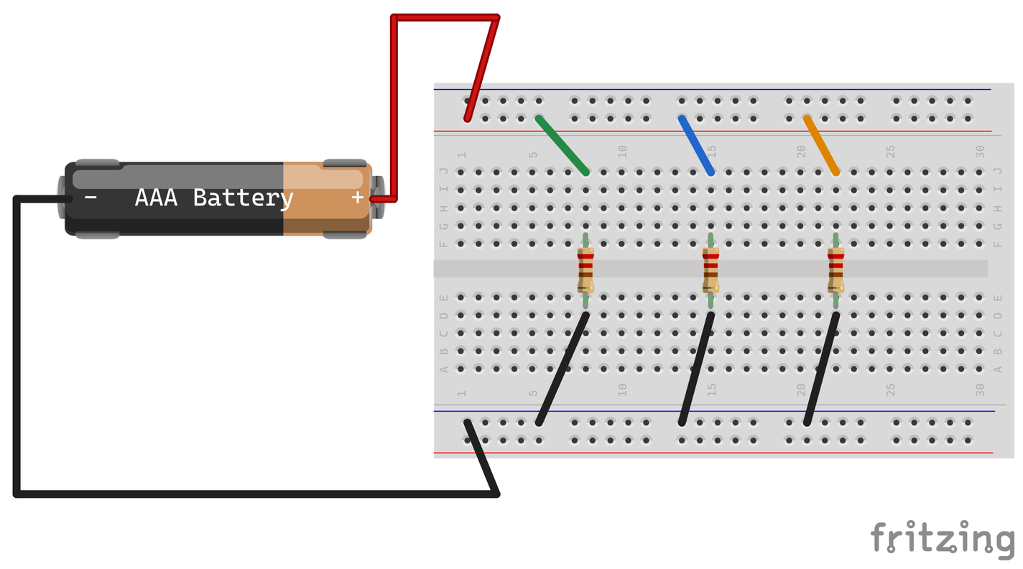
LAB 1 STEP 2 OF 5 BREADBOARD CHECK
2 / 27
Three parallel branches
YOUR STATION
3 V (2×AAA) pack, three 220 Ω resistors, board, meter, jumpers and paper.
UNPOWERED CHECK
Check hole groups, rail breaks and each isolated resistor in Ω. Record R1–R3.
BUILD
Place R1–R3 across the center gap at 8, 15 and 22. Feed each from + and return each to −.
R1 left, R2 middle, R3 right. Green, blue and orange feeds share the + rail.
CHECK
Record on paper. Check actual rail continuity and ask for a wiring check before powering.
DC Theory Chapter 5 Student labs 3 V pack (2×AAA) Slide 2 of 27
Notes:
Record predictions, readings with units and explanations on paper. Follow your actual meter input and range labels. Disconnect before wire or lead changes.
Source: NJATC DC Theory, 3rd edition, ISBN 9781935941125, Chapter 5, printed pp. 114–115. Book figures cropped from supplied Ch05DCTheory photos. See assets/sources.json for exact source photo and crop. Circuit: assets/parallel-build.fzz, native Fritzing 1.0.8 bundled parts, schematic connection model rather than a physical-build test. Holder artwork depicts one cell but the actual classroom source is one two-AAA pack, nominal 3 V.
Classroom source: ONE nominal 3 V battery pack containing TWO 1.5 V AAA cells in series. Use actual measured loaded voltage and component values for calculations. The one-cell breadboard artwork does not change the source voltage.

Slide 3
LAB 1 STEP 3 OF 5 SCHEMATIC FIRST
3 / 27
Voltage across each branch
METER SETUP
Use V/Ω and COM. Select DC volts. Power the checked circuit.
R1
220 Ω
SOURCE READING
+
Measure across the pack and record its actual voltage.
B1
3 V
2×AAA
+
R2
220 Ω
V
R3
220 Ω
−
COM
BRANCH READINGS
Predict branch volts. Measure R1–R3: red toward +, COM toward −.
Schematic first. Try the connections before opening the next breadboard view.
CHECK
Record source V, V1, V2 and V3. Keep probe tips from bridging adjacent strips.
DC Theory Chapter 5 Student labs 3 V pack (2×AAA) Slide 3 of 27
Notes:
Record predictions, readings with units and explanations on paper. Follow your actual meter input and range labels. Disconnect before wire or lead changes.
Source: NJATC DC Theory, 3rd edition, ISBN 9781935941125, Chapter 5, printed pp. 114–115. Book figures cropped from supplied Ch05DCTheory photos. See assets/sources.json for exact source photo and crop. Circuit: assets/parallel-voltage.fzz, native Fritzing 1.0.8 bundled parts, schematic connection model rather than a physical-build test. Holder artwork depicts one cell but the actual classroom source is one two-AAA pack, nominal 3 V.
Classroom source: ONE nominal 3 V battery pack containing TWO 1.5 V AAA cells in series. Use actual measured loaded voltage and component values for calculations. The one-cell breadboard artwork does not change the source voltage. This editable wiring schematic precedes the matching physical breadboard view. Attempt the circuit with power off, then compare the next slide. A is a current meter in series, V is a voltmeter across two points, Ω is an unpowered resistance measurement. Symbols identify electrical connectivity, not physical terminal locations.

Slide 4
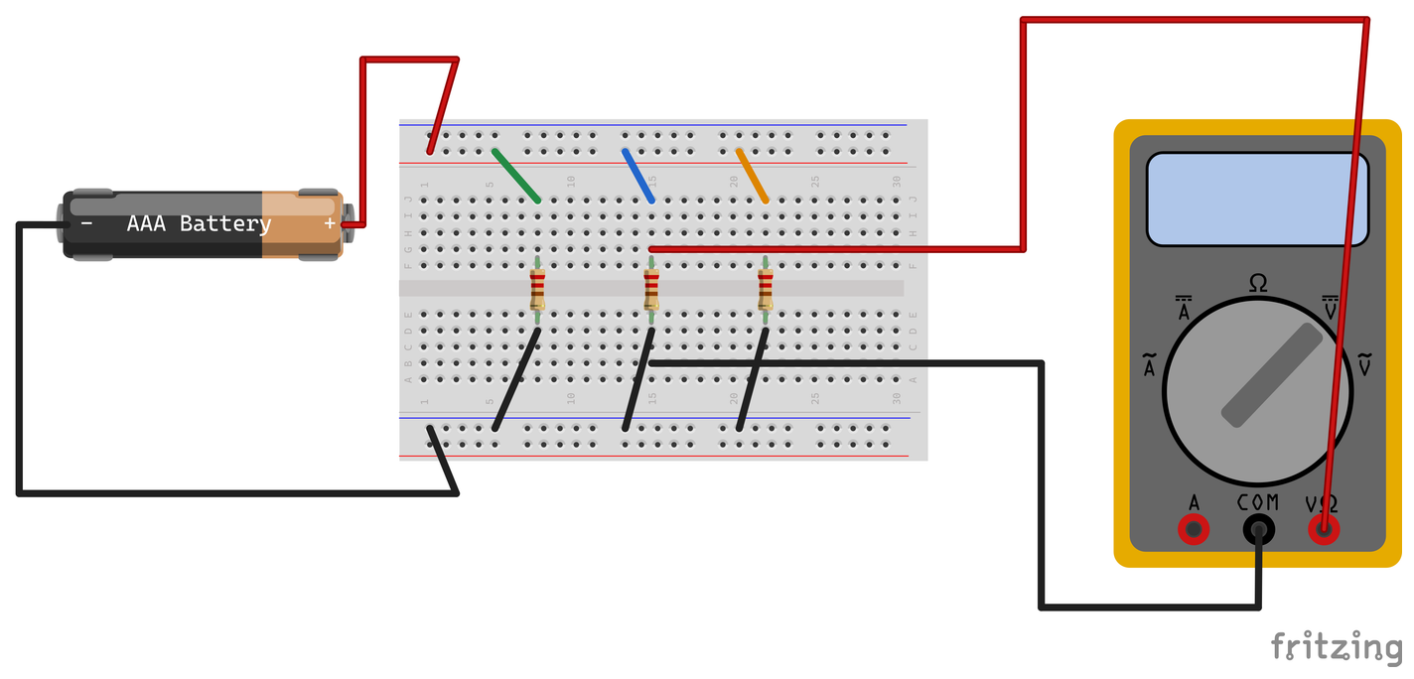
LAB 1 STEP 4 OF 5 BREADBOARD CHECK
4 / 27
Voltage across each branch
METER SETUP
Use V/Ω and COM. Select DC volts. Power the checked circuit.
SOURCE READING
Measure across the pack and record its actual voltage.
BRANCH READINGS
Predict branch volts. Measure R1–R3: red toward +, COM toward −.
Probes span R2. Keep every branch connected during voltage measurements.
CHECK
Record source V, V1, V2 and V3. Keep probe tips from bridging adjacent strips.
DC Theory Chapter 5 Student labs 3 V pack (2×AAA) Slide 4 of 27
Notes:
Record predictions, readings with units and explanations on paper. Follow your actual meter input and range labels. Disconnect before wire or lead changes.
Source: NJATC DC Theory, 3rd edition, ISBN 9781935941125, Chapter 5, printed pp. 114–115. Book figures cropped from supplied Ch05DCTheory photos. See assets/sources.json for exact source photo and crop. Circuit: assets/parallel-voltage.fzz, native Fritzing 1.0.8 bundled parts, schematic connection model rather than a physical-build test. Holder artwork depicts one cell but the actual classroom source is one two-AAA pack, nominal 3 V.
Classroom source: ONE nominal 3 V battery pack containing TWO 1.5 V AAA cells in series. Use actual measured loaded voltage and component values for calculations. The one-cell breadboard artwork does not change the source voltage.

Slide 5
LAB 1 STEP 5 OF 5
5 / 27
Branch voltage results
Copy the table. Predict from your measured source voltage.
ACROSS | PREDICT (V) | MEASURE (V)
Source | Your source reading | Your reading
R1 | Your prediction | Your reading
R2 | Your prediction | Your reading
R3 | Your prediction | Your reading
CHECK
Why does each branch receive the full source voltage?
DC Theory Chapter 5 Student labs 3 V pack (2×AAA) Slide 5 of 27
Notes:
Record predictions, readings with units and explanations on paper. Follow your actual meter input and range labels. Disconnect before wire or lead changes.
Source: NJATC DC Theory, 3rd edition, ISBN 9781935941125, Chapter 5, printed pp. 114–115. Book figures cropped from supplied Ch05DCTheory photos. See assets/sources.json for exact source photo and crop.
Classroom source: ONE nominal 3 V battery pack containing TWO 1.5 V AAA cells in series. Use actual measured loaded voltage and component values for calculations. The one-cell breadboard artwork does not change the source voltage.

Slide 6
LAB 2 STEP 1 OF 5 SCHEMATIC FIRST
6 / 27
Total current measurement
POWER OFF
Predict total mA from Lab 1 V and R1–R3. Disconnect the pack’s negative return.
METER IN THE GAP
+
Select suitable fused DC current input/range. Red to − rail, COM to pack negative.
B1
3 V
2×AAA
R1
220 Ω
R2
220 Ω
R3
220 Ω
−
+
CHECK AND MEASURE
A
Ask for a check. Power and record total mA. Disconnect before moving any leads.
COM
Schematic first. Try the connections before opening the next breadboard view.
CHECK
Never place a current meter across the pack. Follow your meter’s fused jack and range labels.
DC Theory Chapter 5 Student labs 3 V pack (2×AAA) Slide 6 of 27
Notes:
Record predictions, readings with units and explanations on paper. Follow your actual meter input and range labels. Disconnect before wire or lead changes.
Source: NJATC DC Theory, 3rd edition, ISBN 9781935941125, Chapter 5, printed pp. 115–117. Book figures cropped from supplied Ch05DCTheory photos. See assets/sources.json for exact source photo and crop. Circuit: assets/parallel-total-current.fzz, native Fritzing 1.0.8 bundled parts, schematic connection model rather than a physical-build test. Holder artwork depicts one cell but the actual classroom source is one two-AAA pack, nominal 3 V.
Classroom source: ONE nominal 3 V battery pack containing TWO 1.5 V AAA cells in series. Use actual measured loaded voltage and component values for calculations. The one-cell breadboard artwork does not change the source voltage. This editable wiring schematic precedes the matching physical breadboard view. Attempt the circuit with power off, then compare the next slide. A is a current meter in series, V is a voltmeter across two points, Ω is an unpowered resistance measurement. Symbols identify electrical connectivity, not physical terminal locations.

Slide 7
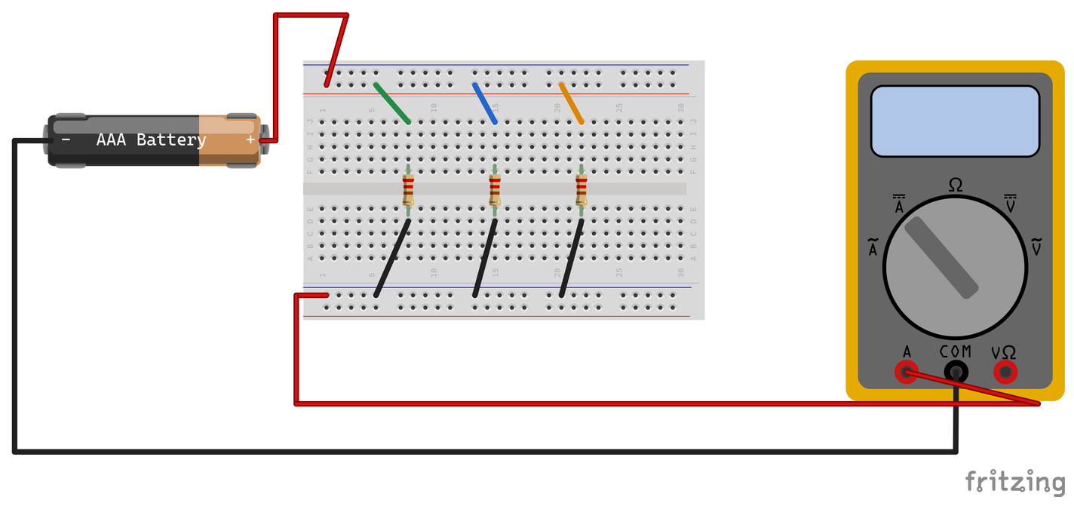
LAB 2 STEP 2 OF 5 BREADBOARD CHECK
7 / 27
Total current measurement
POWER OFF
Predict total mA from Lab 1 V and R1–R3. Disconnect the pack’s negative return.
METER IN THE GAP
Select suitable fused DC current input/range. Red to − rail, COM to pack negative.
CHECK AND MEASURE
Ask for a check. Power and record total mA. Disconnect before moving any leads.
The ammeter completes the pack return. It carries all three branch currents.
CHECK
Never place a current meter across the pack. Follow your meter’s fused jack and range labels.
DC Theory Chapter 5 Student labs 3 V pack (2×AAA) Slide 7 of 27
Notes:
Record predictions, readings with units and explanations on paper. Follow your actual meter input and range labels. Disconnect before wire or lead changes.
Source: NJATC DC Theory, 3rd edition, ISBN 9781935941125, Chapter 5, printed pp. 115–117. Book figures cropped from supplied Ch05DCTheory photos. See assets/sources.json for exact source photo and crop. Circuit: assets/parallel-total-current.fzz, native Fritzing 1.0.8 bundled parts, schematic connection model rather than a physical-build test. Holder artwork depicts one cell but the actual classroom source is one two-AAA pack, nominal 3 V.
Classroom source: ONE nominal 3 V battery pack containing TWO 1.5 V AAA cells in series. Use actual measured loaded voltage and component values for calculations. The one-cell breadboard artwork does not change the source voltage.

Slide 8
LAB 2 STEP 3 OF 5 SCHEMATIC FIRST
8 / 27
Current through one branch
POWER OFF AND RESTORE
Predict mA = 1000 × V ÷ Ω. Power off; restore return. Open R2’s blue feed.
+
A
COM
METER IN THAT GAP
+
Put the fused current meter in that gap. Red toward +, COM toward R2. Check and measure.
B1
3 V
2×AAA
R1
220 Ω
R2
220 Ω
R3
220 Ω
−
REPEAT FOR R1 AND R3
Disconnect for each move. Restore a feed before opening the next.
Schematic first. Try the connections before opening the next breadboard view.
CHECK
Finish with power off, all feeds restored and the red lead back in V/Ω.
DC Theory Chapter 5 Student labs 3 V pack (2×AAA) Slide 8 of 27
Notes:
Record predictions, readings with units and explanations on paper. Follow your actual meter input and range labels. Disconnect before wire or lead changes.
Source: NJATC DC Theory, 3rd edition, ISBN 9781935941125, Chapter 5, printed pp. 115–117. Book figures cropped from supplied Ch05DCTheory photos. See assets/sources.json for exact source photo and crop. Circuit: assets/parallel-branch-current.fzz, native Fritzing 1.0.8 bundled parts, schematic connection model rather than a physical-build test. Holder artwork depicts one cell but the actual classroom source is one two-AAA pack, nominal 3 V.
Classroom source: ONE nominal 3 V battery pack containing TWO 1.5 V AAA cells in series. Use actual measured loaded voltage and component values for calculations. The one-cell breadboard artwork does not change the source voltage. This editable wiring schematic precedes the matching physical breadboard view. Attempt the circuit with power off, then compare the next slide. A is a current meter in series, V is a voltmeter across two points, Ω is an unpowered resistance measurement. Symbols identify electrical connectivity, not physical terminal locations.

Slide 9
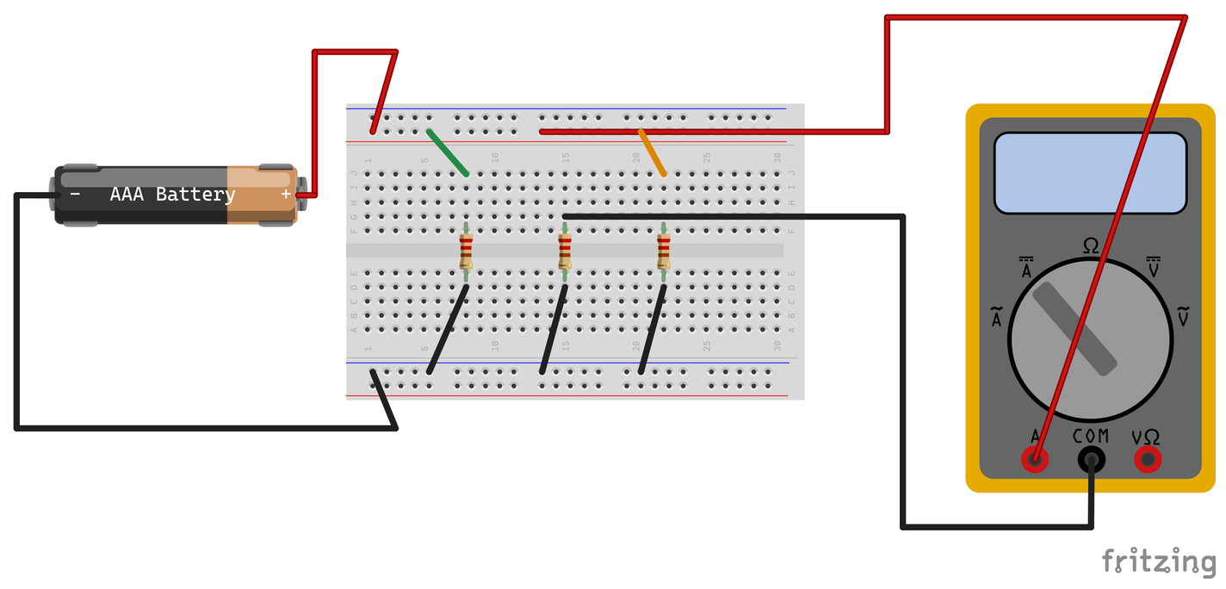
LAB 2 STEP 4 OF 5 BREADBOARD CHECK
9 / 27
Current through one branch
POWER OFF AND RESTORE
Predict mA = 1000 × V ÷ Ω. Power off; restore return. Open R2’s blue feed.
METER IN THAT GAP
Red current lead to + rail. COM to R2’s upper strip. Power after a check.
REPEAT FOR R1 AND R3
Disconnect for each move. Restore a feed before opening the next.
R2 measurement shown. R1’s green and R3’s orange feeds remain connected.
CHECK
Finish with power off, all feeds restored and the red lead back in V/Ω.
DC Theory Chapter 5 Student labs 3 V pack (2×AAA) Slide 9 of 27
Notes:
Record predictions, readings with units and explanations on paper. Follow your actual meter input and range labels. Disconnect before wire or lead changes.
Source: NJATC DC Theory, 3rd edition, ISBN 9781935941125, Chapter 5, printed pp. 115–117. Book figures cropped from supplied Ch05DCTheory photos. See assets/sources.json for exact source photo and crop. Circuit: assets/parallel-branch-current.fzz, native Fritzing 1.0.8 bundled parts, schematic connection model rather than a physical-build test. Holder artwork depicts one cell but the actual classroom source is one two-AAA pack, nominal 3 V.
Classroom source: ONE nominal 3 V battery pack containing TWO 1.5 V AAA cells in series. Use actual measured loaded voltage and component values for calculations. The one-cell breadboard artwork does not change the source voltage.

Slide 10
LAB 2 STEP 5 OF 5
10 / 27
Current results
Use I(A) = source V ÷ branch Ω. Multiply by 1000 for mA.
CURRENT | PREDICT (mA) | MEASURE (mA)
R1 branch | Your calculation | Your reading
R2 branch | Your calculation | Your reading
R3 branch | Your calculation | Your reading
Source total | Add predictions | Your reading
CHECK
Add your measured branch currents. How close is the sum to your measured total?
DC Theory Chapter 5 Student labs 3 V pack (2×AAA) Slide 10 of 27
Notes:
Record predictions, readings with units and explanations on paper. Follow your actual meter input and range labels. Disconnect before wire or lead changes.
Source: NJATC DC Theory, 3rd edition, ISBN 9781935941125, Chapter 5, printed pp. 115–117. Book figures cropped from supplied Ch05DCTheory photos. See assets/sources.json for exact source photo and crop.
Classroom source: ONE nominal 3 V battery pack containing TWO 1.5 V AAA cells in series. Use actual measured loaded voltage and component values for calculations. The one-cell breadboard artwork does not change the source voltage.

Slide 11
LAB 3 STEP 1 OF 4 SCHEMATIC FIRST
11 / 27
Isolated parallel resistance
SOURCE REMOVED
PACK DISCONNECTED
Disconnect both pack leads from the circuit. Keep all three parallel branches.
V/Ω
METER SETUP
Ω
Put red in V/Ω and black in COM. Select Ω.
R1
220 Ω
R2
220 Ω
R3
220 Ω
COM
MEASURE THE NETWORK
Predict Rt for three branches. Probe the common + and − nodes, then record Ω.
Schematic first. Try the connections before opening the next breadboard view.
CHECK
Use Ω mode only on an unpowered circuit with the source disconnected.
DC Theory Chapter 5 Student labs 3 V pack (2×AAA) Slide 11 of 27
Notes:
Record predictions, readings with units and explanations on paper. Follow your actual meter input and range labels. Disconnect before wire or lead changes.
Source: NJATC DC Theory, 3rd edition, ISBN 9781935941125, Chapter 5, printed pp. 118–122. Book figures cropped from supplied Ch05DCTheory photos. See assets/sources.json for exact source photo and crop. Circuit: assets/parallel-ohms.fzz, native Fritzing 1.0.8 bundled parts, schematic connection model rather than a physical-build test. Holder artwork depicts one cell but the actual classroom source is one two-AAA pack, nominal 3 V.
Classroom source: ONE nominal 3 V battery pack containing TWO 1.5 V AAA cells in series. Use actual measured loaded voltage and component values for calculations. The one-cell breadboard artwork does not change the source voltage. This editable wiring schematic precedes the matching physical breadboard view. Attempt the circuit with power off, then compare the next slide. A is a current meter in series, V is a voltmeter across two points, Ω is an unpowered resistance measurement. Symbols identify electrical connectivity, not physical terminal locations.

Slide 12
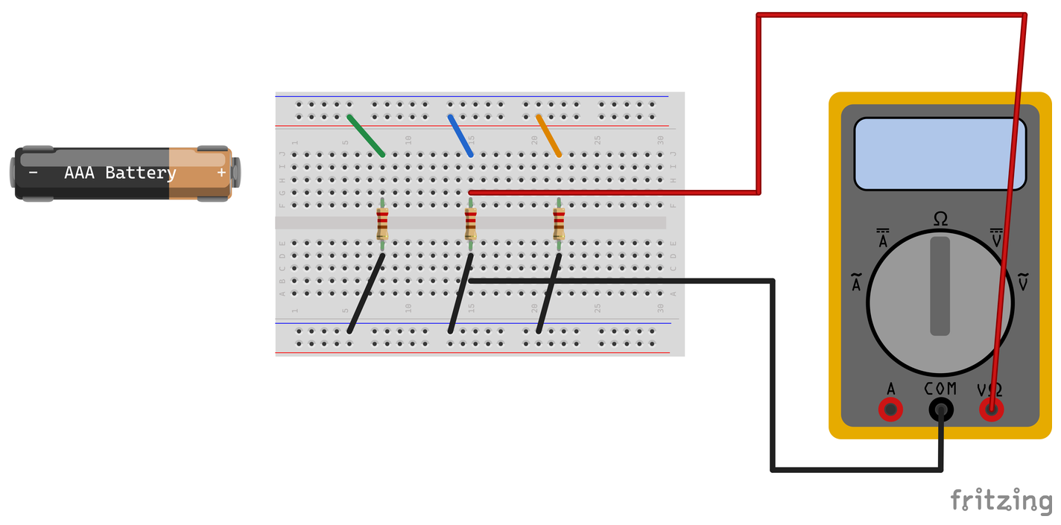
LAB 3 STEP 2 OF 4 BREADBOARD CHECK
12 / 27
Isolated parallel resistance
SOURCE REMOVED
Disconnect both pack leads from the circuit. Keep all three parallel branches.
METER SETUP
Put red in V/Ω and black in COM. Select Ω.
MEASURE THE NETWORK
Predict Rt for three branches. Probe the common + and − nodes, then record Ω.
The pack is completely isolated. The ohmmeter spans the parallel network.
CHECK
Use Ω mode only on an unpowered circuit with the source disconnected.
DC Theory Chapter 5 Student labs 3 V pack (2×AAA) Slide 12 of 27
Notes:
Record predictions, readings with units and explanations on paper. Follow your actual meter input and range labels. Disconnect before wire or lead changes.
Source: NJATC DC Theory, 3rd edition, ISBN 9781935941125, Chapter 5, printed pp. 118–122. Book figures cropped from supplied Ch05DCTheory photos. See assets/sources.json for exact source photo and crop. Circuit: assets/parallel-ohms.fzz, native Fritzing 1.0.8 bundled parts, schematic connection model rather than a physical-build test. Holder artwork depicts one cell but the actual classroom source is one two-AAA pack, nominal 3 V.
Classroom source: ONE nominal 3 V battery pack containing TWO 1.5 V AAA cells in series. Use actual measured loaded voltage and component values for calculations. The one-cell breadboard artwork does not change the source voltage.

Slide 13
LAB 3 STEP 3 OF 4
13 / 27
One, two and three branches
ONE BRANCH
Keep the source disconnected. Remove the blue R2 and orange R3 positive feeds. Measure Ω.
TWO BRANCHES
Restore the blue R2 feed. Leave the orange R3 feed open. Measure Ω at the same two nodes.
THREE BRANCHES
Restore the orange R3 feed. Measure Ω again. Calculate predictions using your resistor readings.
CHECK
Predict each network first. Keep all returns connected and the pack disconnected.
DC Theory Chapter 5 Student labs 3 V pack (2×AAA) Slide 13 of 27
Notes:
Record predictions, readings with units and explanations on paper. Follow your actual meter input and range labels. Disconnect before wire or lead changes.
Source: NJATC DC Theory, 3rd edition, ISBN 9781935941125, Chapter 5, printed pp. 118–122. Book figures cropped from supplied Ch05DCTheory photos. See assets/sources.json for exact source photo and crop.
Classroom source: ONE nominal 3 V battery pack containing TWO 1.5 V AAA cells in series. Use actual measured loaded voltage and component values for calculations. The one-cell breadboard artwork does not change the source voltage.

Slide 14
LAB 3 STEP 4 OF 4
14 / 27
Parallel resistance results
Copy the table. Use Rt = 1 ÷ (1/R1 + 1/R2 + …) for the connected branches.
CONNECTED | PREDICT (Ω) | MEASURE (Ω)
R1 only | Your R1 | Your reading
R1 and R2 | Your calculation | Your reading
R1, R2 and R3 | Your calculation | Your reading
CHECK
What happens to total resistance as you add a parallel path?
DC Theory Chapter 5 Student labs 3 V pack (2×AAA) Slide 14 of 27
Notes:
Record predictions, readings with units and explanations on paper. Follow your actual meter input and range labels. Disconnect before wire or lead changes.
Source: NJATC DC Theory, 3rd edition, ISBN 9781935941125, Chapter 5, printed pp. 118–122. Book figures cropped from supplied Ch05DCTheory photos. See assets/sources.json for exact source photo and crop.
Classroom source: ONE nominal 3 V battery pack containing TWO 1.5 V AAA cells in series. Use actual measured loaded voltage and component values for calculations. The one-cell breadboard artwork does not change the source voltage.

Slide 15
LAB 4 STEP 1 OF 5 SCHEMATIC FIRST
15 / 27
Two unequal branches
POWER OFF
BRANCH A
BRANCH B
Branch A uses R1 alone. Branch B uses R2 and R3 in series.
R2
220 Ω
TWO COMMON NODES
+
Connect the whole of each branch between source positive and negative.
B1
3 V
2×AAA
R1
220 Ω
−
R3
220 Ω
PATH CHECK
Keep only two complete branches. Ask for a wiring check before power.
Schematic first. Try the connections before opening the next breadboard view.
CHECK
Predict branch currents first. Try the schematic, then compare the next breadboard view.
DC Theory Chapter 5 Student labs 3 V pack (2×AAA) Slide 15 of 27
Notes:
Record predictions, readings with units and explanations on paper. Follow your actual meter input and range labels. Disconnect before wire or lead changes.
Source: NJATC DC Theory, 3rd edition, ISBN 9781935941125, Chapter 5, printed pp. 116–117,120–123. Book figures cropped from supplied Ch05DCTheory photos. See assets/sources.json for exact source photo and crop. Circuit: assets/unequal-build.fzz, native Fritzing 1.0.8 bundled parts, schematic connection model rather than a physical-build test. Holder artwork depicts one cell but the actual classroom source is one two-AAA pack, nominal 3 V.
Classroom source: ONE nominal 3 V battery pack containing TWO 1.5 V AAA cells in series. Use actual measured loaded voltage and component values for calculations. The one-cell breadboard artwork does not change the source voltage. This editable wiring schematic precedes the matching physical breadboard view. Attempt the circuit with power off, then compare the next slide. A is a current meter in series, V is a voltmeter across two points, Ω is an unpowered resistance measurement. Symbols identify electrical connectivity, not physical terminal locations.

Slide 16
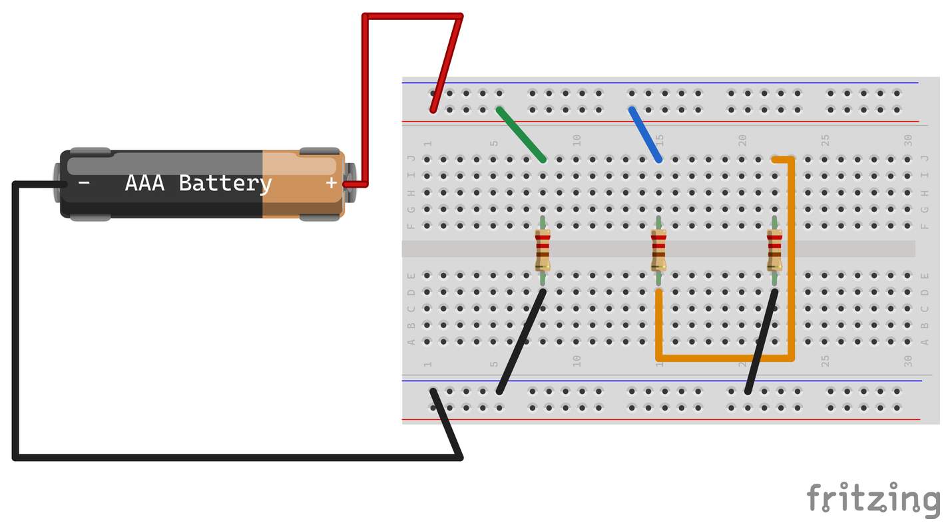
LAB 4 STEP 2 OF 5 BREADBOARD CHECK
16 / 27
Two unequal branches
POWER OFF
Branch A uses R1 alone. Branch B uses R2 and R3 in series.
REWIRE BRANCH B
Remove R3’s orange + feed and R2’s black return. Link R2 lower to R3 upper.
TRACE THE PATHS
Trace A: +, R1, −. B: +, R2, R3, −. Get a wiring check.
The orange link joins D15 to J22. A is about 220 Ω. B is about 440 Ω.
CHECK
Predict A and B current first. Keep R1 feed/return, R2 blue feed and R3 black return.
DC Theory Chapter 5 Student labs 3 V pack (2×AAA) Slide 16 of 27
Notes:
Record predictions, readings with units and explanations on paper. Follow your actual meter input and range labels. Disconnect before wire or lead changes.
Source: NJATC DC Theory, 3rd edition, ISBN 9781935941125, Chapter 5, printed pp. 116–117,120–123. Book figures cropped from supplied Ch05DCTheory photos. See assets/sources.json for exact source photo and crop. Circuit: assets/unequal-build.fzz, native Fritzing 1.0.8 bundled parts, schematic connection model rather than a physical-build test. Holder artwork depicts one cell but the actual classroom source is one two-AAA pack, nominal 3 V.
Classroom source: ONE nominal 3 V battery pack containing TWO 1.5 V AAA cells in series. Use actual measured loaded voltage and component values for calculations. The one-cell breadboard artwork does not change the source voltage.

Slide 17
LAB 4 STEP 3 OF 5 SCHEMATIC FIRST
17 / 27
Unequal branch measurements
DC VOLTS FIRST
BRANCH A
BRANCH B
Measure across A and across all of B. Record both. Then disconnect the pack.
+
A
COM
CURRENT IN BRANCH B
+
R2
220 Ω
Insert the fused meter in B’s input. Red toward +, COM toward R2. Check and read mA.
B1
3 V
2×AAA
R1
220 Ω
−
R3
220 Ω
CURRENT IN BRANCH A
Power off. Restore B’s input. Move the meter into A. Check, measure and restore with power off.
Schematic first. Try the connections before opening the next breadboard view.
CHECK
Disconnect for every lead move. Use a suitable fused current range. Return red to V/Ω.
DC Theory Chapter 5 Student labs 3 V pack (2×AAA) Slide 17 of 27
Notes:
Record predictions, readings with units and explanations on paper. Follow your actual meter input and range labels. Disconnect before wire or lead changes.
Source: NJATC DC Theory, 3rd edition, ISBN 9781935941125, Chapter 5, printed pp. 116–117,120–123. Book figures cropped from supplied Ch05DCTheory photos. See assets/sources.json for exact source photo and crop. Circuit: assets/unequal-branch-current.fzz, native Fritzing 1.0.8 bundled parts, schematic connection model rather than a physical-build test. Holder artwork depicts one cell but the actual classroom source is one two-AAA pack, nominal 3 V.
Classroom source: ONE nominal 3 V battery pack containing TWO 1.5 V AAA cells in series. Use actual measured loaded voltage and component values for calculations. The one-cell breadboard artwork does not change the source voltage. This editable wiring schematic precedes the matching physical breadboard view. Attempt the circuit with power off, then compare the next slide. A is a current meter in series, V is a voltmeter across two points, Ω is an unpowered resistance measurement. Symbols identify electrical connectivity, not physical terminal locations.

Slide 18
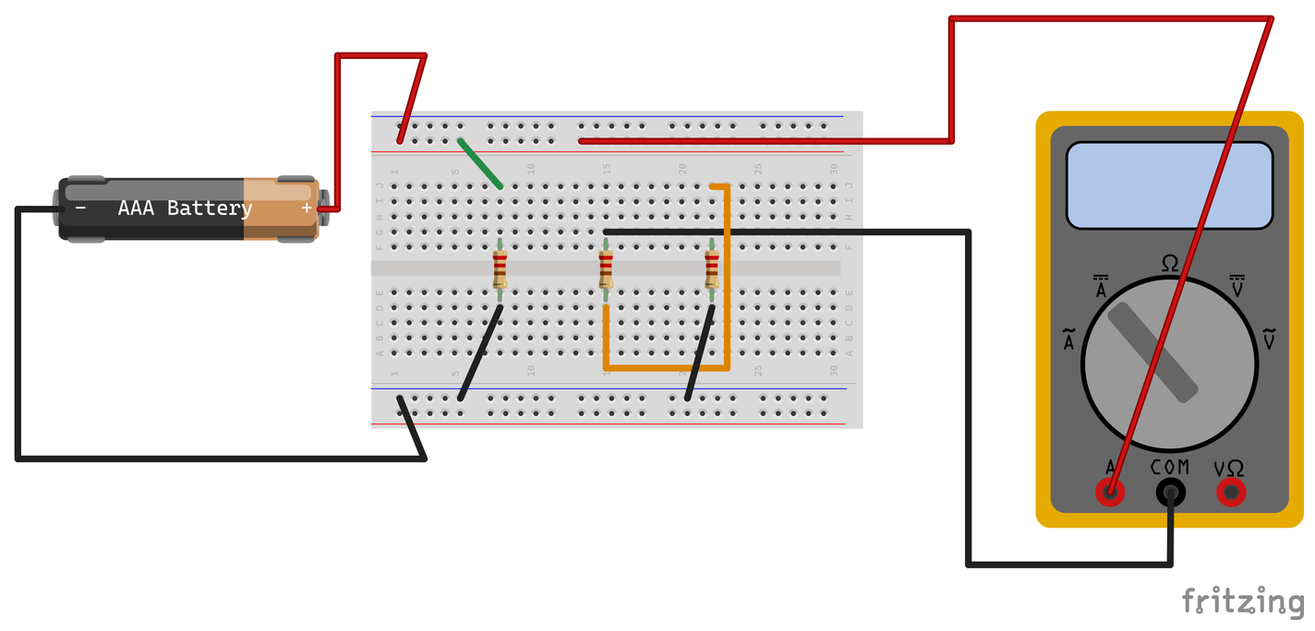
LAB 4 STEP 4 OF 5 BREADBOARD CHECK
18 / 27
Unequal branch measurements
DC VOLTS FIRST
Measure across A and across all of B. Record both. Then disconnect the pack.
CURRENT IN BRANCH B
Replace the blue R2 feed with the current meter. Red to + rail, COM to R2 upper.
CURRENT IN BRANCH A
Power off. Restore blue. Meter replaces green. Check, measure, power off and restore.
Branch B current shown. Its two series resistors carry the same current.
CHECK
Disconnect for every lead move. Use a suitable fused current range. Return red to V/Ω.
DC Theory Chapter 5 Student labs 3 V pack (2×AAA) Slide 18 of 27
Notes:
Record predictions, readings with units and explanations on paper. Follow your actual meter input and range labels. Disconnect before wire or lead changes.
Source: NJATC DC Theory, 3rd edition, ISBN 9781935941125, Chapter 5, printed pp. 116–117,120–123. Book figures cropped from supplied Ch05DCTheory photos. See assets/sources.json for exact source photo and crop. Circuit: assets/unequal-branch-current.fzz, native Fritzing 1.0.8 bundled parts, schematic connection model rather than a physical-build test. Holder artwork depicts one cell but the actual classroom source is one two-AAA pack, nominal 3 V.
Classroom source: ONE nominal 3 V battery pack containing TWO 1.5 V AAA cells in series. Use actual measured loaded voltage and component values for calculations. The one-cell breadboard artwork does not change the source voltage.

Slide 19
LAB 4 STEP 5 OF 5
19 / 27
Unequal branch results
Use the voltage across the whole branch in I = V ÷ Rbranch.
CURRENT | PREDICT (mA) | RESULT (mA)
A: R1 | Your calculation | Your reading
B: R2 + R3 | Your calculation | Your reading
Total: A + B | Add predictions | Add readings
CHECK
Sum unrounded branch currents. Round the total last. Which branch draws more, and why?
DC Theory Chapter 5 Student labs 3 V pack (2×AAA) Slide 19 of 27
Notes:
Record predictions, readings with units and explanations on paper. Follow your actual meter input and range labels. Disconnect before wire or lead changes.
Source: NJATC DC Theory, 3rd edition, ISBN 9781935941125, Chapter 5, printed pp. 116–117,120–123. Book figures cropped from supplied Ch05DCTheory photos. See assets/sources.json for exact source photo and crop.
Classroom source: ONE nominal 3 V battery pack containing TWO 1.5 V AAA cells in series. Use actual measured loaded voltage and component values for calculations. The one-cell breadboard artwork does not change the source voltage.

Slide 20
LAB 5 STEP 1 OF 5 SCHEMATIC FIRST
20 / 27
An open parallel branch
RESTORE FIRST
Power off. Remove the series link. Restore R2’s return and R3’s orange feed.
+
OPEN
V
OPEN ONLY R2
+
COM
Predict voltage/current changes. Remove only R2’s blue feed. Keep its return and the other branches.
B1
3 V
2×AAA
R1
220 Ω
R2
220 Ω
R3
220 Ω
−
DC VOLTAGE TEST
Power after a check. Record R1, R3, R2 and the voltage across the missing feed.
Schematic first. Try the connections before opening the next breadboard view.
CHECK
The V meter spans the open feed. Keep the opening in place while taking its voltage.
DC Theory Chapter 5 Student labs 3 V pack (2×AAA) Slide 20 of 27
Notes:
Record predictions, readings with units and explanations on paper. Follow your actual meter input and range labels. Disconnect before wire or lead changes.
Source: NJATC DC Theory, 3rd edition, ISBN 9781935941125, Chapter 5, printed pp. 114–118,127. Book figures cropped from supplied Ch05DCTheory photos. See assets/sources.json for exact source photo and crop. Circuit: assets/open-branch-voltage.fzz, native Fritzing 1.0.8 bundled parts, schematic connection model rather than a physical-build test. Holder artwork depicts one cell but the actual classroom source is one two-AAA pack, nominal 3 V.
Classroom source: ONE nominal 3 V battery pack containing TWO 1.5 V AAA cells in series. Use actual measured loaded voltage and component values for calculations. The one-cell breadboard artwork does not change the source voltage. This editable wiring schematic precedes the matching physical breadboard view. Attempt the circuit with power off, then compare the next slide. A is a current meter in series, V is a voltmeter across two points, Ω is an unpowered resistance measurement. Symbols identify electrical connectivity, not physical terminal locations.

Slide 21

LAB 5 STEP 2 OF 5 BREADBOARD CHECK
21 / 27
An open parallel branch
RESTORE FIRST
Power off. Remove the series link. Restore R2’s return and R3’s orange feed.
OPEN ONLY R2
Predict voltage/current changes. Remove only R2’s blue feed. Keep its return and the other branches.
DC VOLTAGE TEST
Power after a check. Record R1, R3, R2 and the voltage across the missing feed.
The meter spans the open blue-feed gap. The two other branches still operate.
CHECK
Use V/Ω and COM. The gap test uses a voltmeter while the blue feed remains removed.
DC Theory Chapter 5 Student labs 3 V pack (2×AAA) Slide 21 of 27
Notes:
Record predictions, readings with units and explanations on paper. Follow your actual meter input and range labels. Disconnect before wire or lead changes.
Source: NJATC DC Theory, 3rd edition, ISBN 9781935941125, Chapter 5, printed pp. 114–118,127. Book figures cropped from supplied Ch05DCTheory photos. See assets/sources.json for exact source photo and crop. Circuit: assets/open-branch-voltage.fzz, native Fritzing 1.0.8 bundled parts, schematic connection model rather than a physical-build test. Holder artwork depicts one cell but the actual classroom source is one two-AAA pack, nominal 3 V.
Classroom source: ONE nominal 3 V battery pack containing TWO 1.5 V AAA cells in series. Use actual measured loaded voltage and component values for calculations. The one-cell breadboard artwork does not change the source voltage.

Slide 22
LAB 5 STEP 3 OF 5 SCHEMATIC FIRST
22 / 27
Total current with R2 open
POWER OFF
Power off. Leave R2’s input open. Open the source negative return for the current meter.
OPEN
TOTAL CURRENT TEST
+
Use the fused current setup from Lab 2. Red to − rail, COM to pack negative.
B1
3 V
2×AAA
R1
220 Ω
R2
220 Ω
R3
220 Ω
−
+
RECORD AND RESTORE
A
Record total mA. Power off, restore pack return and blue feed. Return red to V/Ω.
COM
Schematic first. Try the connections before opening the next breadboard view.
CHECK
Compare this total with Lab 2. Never bridge the + and − rails with the current meter.
DC Theory Chapter 5 Student labs 3 V pack (2×AAA) Slide 22 of 27
Notes:
Record predictions, readings with units and explanations on paper. Follow your actual meter input and range labels. Disconnect before wire or lead changes.
Source: NJATC DC Theory, 3rd edition, ISBN 9781935941125, Chapter 5, printed pp. 114–118,127. Book figures cropped from supplied Ch05DCTheory photos. See assets/sources.json for exact source photo and crop. Circuit: assets/open-total-current.fzz, native Fritzing 1.0.8 bundled parts, schematic connection model rather than a physical-build test. Holder artwork depicts one cell but the actual classroom source is one two-AAA pack, nominal 3 V.
Classroom source: ONE nominal 3 V battery pack containing TWO 1.5 V AAA cells in series. Use actual measured loaded voltage and component values for calculations. The one-cell breadboard artwork does not change the source voltage. This editable wiring schematic precedes the matching physical breadboard view. Attempt the circuit with power off, then compare the next slide. A is a current meter in series, V is a voltmeter across two points, Ω is an unpowered resistance measurement. Symbols identify electrical connectivity, not physical terminal locations.

Slide 23

LAB 5 STEP 4 OF 5 BREADBOARD CHECK
23 / 27
Total current with R2 open
POWER OFF
Leave R2’s blue feed removed. Open the pack’s negative return at the − rail.
TOTAL CURRENT TEST
Use the fused current setup from Lab 2. Red to − rail, COM to pack negative.
RECORD AND RESTORE
Record total mA. Power off, restore pack return and blue feed. Return red to V/Ω.
The meter is in the source return. The missing blue feed still opens only R2.
CHECK
Compare this total with Lab 2. Never bridge the + and − rails with the current meter.
DC Theory Chapter 5 Student labs 3 V pack (2×AAA) Slide 23 of 27
Notes:
Record predictions, readings with units and explanations on paper. Follow your actual meter input and range labels. Disconnect before wire or lead changes.
Source: NJATC DC Theory, 3rd edition, ISBN 9781935941125, Chapter 5, printed pp. 114–118,127. Book figures cropped from supplied Ch05DCTheory photos. See assets/sources.json for exact source photo and crop. Circuit: assets/open-total-current.fzz, native Fritzing 1.0.8 bundled parts, schematic connection model rather than a physical-build test. Holder artwork depicts one cell but the actual classroom source is one two-AAA pack, nominal 3 V.
Classroom source: ONE nominal 3 V battery pack containing TWO 1.5 V AAA cells in series. Use actual measured loaded voltage and component values for calculations. The one-cell breadboard artwork does not change the source voltage.

Slide 24
LAB 5 STEP 5 OF 5
24 / 27
Open branch results
Use Labs 1–2 for the normal circuit. Record the open-feed gap voltage separately.
QUANTITY | NORMAL | R2 OPEN
R1 voltage (V) | Lab 1 reading | Your reading
R3 voltage (V) | Lab 1 reading | Your reading
R2 voltage (V) | Lab 1 reading | Your reading
Total current (mA) | Lab 2 reading | Your reading
CHECK
Why do the other branches keep working? What if the common source return opened?
DC Theory Chapter 5 Student labs 3 V pack (2×AAA) Slide 24 of 27
Notes:
Record predictions, readings with units and explanations on paper. Follow your actual meter input and range labels. Disconnect before wire or lead changes.
Source: NJATC DC Theory, 3rd edition, ISBN 9781935941125, Chapter 5, printed pp. 114–118,127. Book figures cropped from supplied Ch05DCTheory photos. See assets/sources.json for exact source photo and crop.
Classroom source: ONE nominal 3 V battery pack containing TWO 1.5 V AAA cells in series. Use actual measured loaded voltage and component values for calculations. The one-cell breadboard artwork does not change the source voltage.

Slide 25
LAB 6 STEP 1 OF 3
25 / 27
Power from recorded readings
USE THE NORMAL CIRCUIT DATA
Use branch voltages from Lab 1 and branch/total currents from Lab 2. Keep the pack disconnected.
CONVERT AND CALCULATE
Divide mA by 1000 to get A. For each resistor, calculate P(W) = branch V × branch I(A).
SOURCE POWER
Calculate source V × total I(A). Compare it with P1 + P2 + P3.
CHECK
Use the three-parallel-branch readings. Keep unequal-branch and open-branch data separate.
DC Theory Chapter 5 Student labs 3 V pack (2×AAA) Slide 25 of 27
Notes:
Record predictions, readings with units and explanations on paper. Follow your actual meter input and range labels. Disconnect before wire or lead changes.
Source: NJATC DC Theory, 3rd edition, ISBN 9781935941125, Chapter 5, printed pp. 125–126. Book figures cropped from supplied Ch05DCTheory photos. See assets/sources.json for exact source photo and crop.
Classroom source: ONE nominal 3 V battery pack containing TWO 1.5 V AAA cells in series. Use actual measured loaded voltage and component values for calculations. The one-cell breadboard artwork does not change the source voltage.

Slide 26
LAB 6 STEP 2 OF 3
26 / 27
Power results
Copy the table. Show current in amperes before calculating watts.
LOAD | VOLTS | AMPS | POWER (W)
R1 | Lab 1 | Lab 2 ÷ 1000 | Calculate
R2 | Lab 1 | Lab 2 ÷ 1000 | Calculate
R3 | Lab 1 | Lab 2 ÷ 1000 | Calculate
Source | Source reading | Total ÷ 1000 | Calculate
CHECK
Does the sum of branch watts match the source watts within measurement limits?
DC Theory Chapter 5 Student labs 3 V pack (2×AAA) Slide 26 of 27
Notes:
Record predictions, readings with units and explanations on paper. Follow your actual meter input and range labels. Disconnect before wire or lead changes.
Source: NJATC DC Theory, 3rd edition, ISBN 9781935941125, Chapter 5, printed pp. 125–126. Book figures cropped from supplied Ch05DCTheory photos. See assets/sources.json for exact source photo and crop.
Classroom source: ONE nominal 3 V battery pack containing TWO 1.5 V AAA cells in series. Use actual measured loaded voltage and component values for calculations. The one-cell breadboard artwork does not change the source voltage.

Slide 27
LAB 6 STEP 3 OF 3
27 / 27
Ratings and station reset
Ask for the verified resistor power rating. Record each rating in watts.
RESISTOR | CALCULATED (W) | RATING (W) | BELOW RATING?
R1 | Your calculation | Verified value | Yes / No
R2 | Your calculation | Verified value | Yes / No
R3 | Your calculation | Verified value | Yes / No
CHECK
Finish with the pack disconnected, normal feeds restored and the red lead in V/Ω.
DC Theory Chapter 5 Student labs 3 V pack (2×AAA) Slide 27 of 27
Notes:
Record predictions, readings with units and explanations on paper. Follow your actual meter input and range labels. Disconnect before wire or lead changes.
Source: NJATC DC Theory, 3rd edition, ISBN 9781935941125, Chapter 5, printed pp. 125–126. Book figures cropped from supplied Ch05DCTheory photos. See assets/sources.json for exact source photo and crop.
Classroom source: ONE nominal 3 V battery pack containing TWO 1.5 V AAA cells in series. Use actual measured loaded voltage and component values for calculations. The one-cell breadboard artwork does not change the source voltage.

