Slide 1
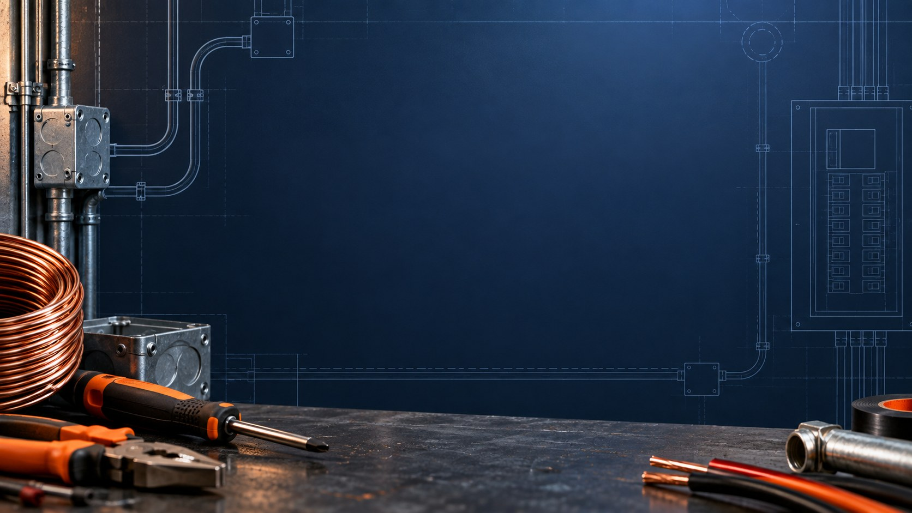
LAB 1 STEP 1 OF 4
1 / 27
Breadboard and resistor check
YOUR STATION
Breadboard, 3 V (2×AAA) pack, three 220 Ω resistors, 5 kΩ pot, red LED, meter, jumpers and paper.
BOARD CHECK
Pack disconnected, leads in V/Ω and COM. Use continuity mode to check hole groups, the center gap and rail breaks.
RESISTOR RECORD
Read the bands and tolerance. Measure each isolated resistor in Ω. Record R1, R2, R3 and their allowed ranges.
CHECK
Record each lab on paper. Complete its measurements before moving to the next slide.
DC Theory Chapter 4 Student labs 3 V pack (2×AAA) Slide 1 of 27
Notes:
Student Lab 1, step 1 of 3. Record predictions, measurements with units, and explanations on paper. Use your actual source voltage and measured component values.
Source: NJATC DC Theory, 3rd edition, ISBN 9781935941125, Chapter 4, pp. 90-93. Activities adapted to a nominal 3 V two-AAA pack and the classroom inventory.
Classroom source: ONE nominal 3 V battery pack containing TWO 1.5 V AAA cells in series. Use actual measured loaded voltage and component values for calculations. The one-cell breadboard artwork does not change the source voltage.

Slide 2
LAB 1 STEP 2 OF 4 SCHEMATIC FIRST
2 / 27
Resistance across a series chain
BUILD WITH POWER OFF
PACK DISCONNECTED
Connect R1, R2 and R3 end to end. Leave both pack leads disconnected from the circuit.
R1
220 Ω
R2
220 Ω
R3
220 Ω
MEASURE IN Ω
Measure across the free ends. Then repeat with R1 and R2 only.
Ω
RECORD
V/Ω
COM
Compare each total with the sum of your isolated resistor readings.
Schematic first. Try the connections before opening the next breadboard view.
CHECK
Use V/Ω and COM. Keep both pack leads disconnected throughout the resistance test.
DC Theory Chapter 4 Student labs 3 V pack (2×AAA) Slide 2 of 27
Notes:
Student Lab 1, step 2 of 3. Record predictions, measurements with units, and explanations on paper. Use your actual source voltage and measured component values.
Source: NJATC DC Theory, 3rd edition, ISBN 9781935941125, Chapter 4, pp. 90-93. Activities adapted to a nominal 3 V two-AAA pack and the classroom inventory.
Circuit image: hands-on-assets/lab1-isolated-resistance.png, from native Fritzing 1.0.8 core parts. Models show electrical connections. Match the actual component pinout and meter jack labels. The holder artwork depicts one cell although the classroom source is two AAA cells.
Classroom source: ONE nominal 3 V battery pack containing TWO 1.5 V AAA cells in series. Use actual measured loaded voltage and component values for calculations. The one-cell breadboard artwork does not change the source voltage. This editable wiring schematic precedes the matching physical breadboard view. Attempt the circuit with power off, then compare the next slide. A is a current meter in series, V is a voltmeter across two points, Ω is an unpowered resistance measurement. Symbols identify electrical connectivity, not physical terminal locations.

Slide 3
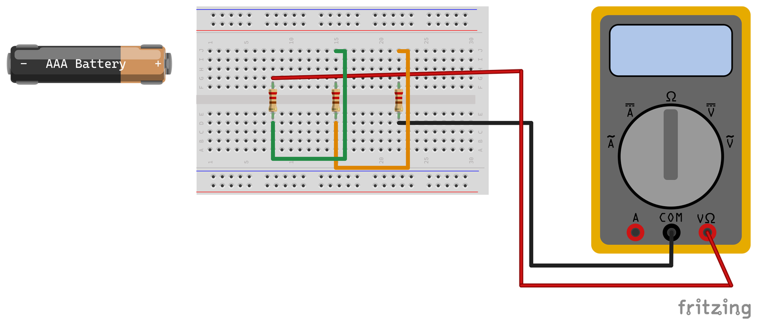
LAB 1 STEP 3 OF 4 BREADBOARD CHECK
3 / 27
Resistance across a series chain
BUILD WITH POWER OFF
Connect R1, R2 and R3 end to end. Leave both pack leads disconnected from the circuit.
MEASURE IN Ω
Measure across the free ends. Then repeat with R1 and R2 only.
RECORD
Compare each total with the sum of your isolated resistor readings.
The meter spans the isolated chain. The disconnected pack stays out of the path.
CHECK
Use V/Ω and COM for resistance. Resistor leads must occupy separate connected strips.
DC Theory Chapter 4 Student labs 3 V pack (2×AAA) Slide 3 of 27
Notes:
Student Lab 1, step 2 of 3. Record predictions, measurements with units, and explanations on paper. Use your actual source voltage and measured component values.
Source: NJATC DC Theory, 3rd edition, ISBN 9781935941125, Chapter 4, pp. 90-93. Activities adapted to a nominal 3 V two-AAA pack and the classroom inventory.
Circuit image: hands-on-assets/lab1-isolated-resistance.png, from native Fritzing 1.0.8 core parts. Models show electrical connections. Match the actual component pinout and meter jack labels. The holder artwork depicts one cell although the classroom source is two AAA cells.
Classroom source: ONE nominal 3 V battery pack containing TWO 1.5 V AAA cells in series. Use actual measured loaded voltage and component values for calculations. The one-cell breadboard artwork does not change the source voltage.

Slide 4
LAB 1 STEP 4 OF 4
4 / 27
Resistance results
Copy the table. Use your resistor values to calculate each prediction.
SETUP | PREDICTION (Ω) | MEASURED (Ω)
R1 only | Your calculation | Your reading
R1 + R2 | Your calculation | Your reading
R1 + R2 + R3 | Your calculation | Your reading
CHECK
Explain any difference using the component tolerances, connections and meter accuracy.
DC Theory Chapter 4 Student labs 3 V pack (2×AAA) Slide 4 of 27
Notes:
Student Lab 1, step 3 of 3. Record predictions, measurements with units, and explanations on paper. Use your actual source voltage and measured component values.
Source: NJATC DC Theory, 3rd edition, ISBN 9781935941125, Chapter 4, pp. 90-93. Activities adapted to a nominal 3 V two-AAA pack and the classroom inventory.
Classroom source: ONE nominal 3 V battery pack containing TWO 1.5 V AAA cells in series. Use actual measured loaded voltage and component values for calculations. The one-cell breadboard artwork does not change the source voltage.

Slide 5
LAB 2 STEP 1 OF 6
5 / 27
Potentiometer terminal check
ISOLATE THE POT
Disconnect the battery. Remove the pot from every other circuit. Use Ω mode.
IDENTIFY A, B AND X
Find the pin pair with constant resistance as you turn the shaft. Label these ends A/B. The other pin is wiper X.
RECORD THREE SETTINGS
At low, middle and high resistance, record A-to-X, X-to-B and their sum. Mark the shaft positions.
CHECK
Identify your actual terminals first. The pictured pot uses A = E5, X = F6 and B = E7.
DC Theory Chapter 4 Student labs 3 V pack (2×AAA) Slide 5 of 27
Notes:
Student Lab 2, step 1 of 4. Record predictions, measurements with units, and explanations on paper. Use your actual source voltage and measured component values.
Source: NJATC DC Theory, 3rd edition, ISBN 9781935941125, Chapter 4, pp. 93-95. Activities adapted to a nominal 3 V two-AAA pack and the classroom inventory.
Classroom source: ONE nominal 3 V battery pack containing TWO 1.5 V AAA cells in series. Use actual measured loaded voltage and component values for calculations. The one-cell breadboard artwork does not change the source voltage.

Slide 6
LAB 2 STEP 2 OF 6 SCHEMATIC FIRST
6 / 27
Separate jumpers at the wiper
RESISTOR TO A
5 kΩ pot
Connect the fixed resistor output to pot end A. Identify A, B and wiper X first.
R1
220 Ω
B
A
WIPER X TO B
+
anode
Connect a jumper from X to unused end B. Keep this link as the shaft turns.
B1
3 V
2×AAA
X
−
cathode
RED LED
X–B jumper
WIPER X TO LED
Connect X to the LED anode. The LED cathode returns to pack negative.
Schematic first. Try the connections before opening the next breadboard view.
CHECK
Try these connections with power off. Compare your work with the next breadboard slide.
DC Theory Chapter 4 Student labs 3 V pack (2×AAA) Slide 6 of 27
Notes:
Student Lab 2, step 2 of 4. Record predictions, measurements with units, and explanations on paper. Use your actual source voltage and measured component values.
Source: NJATC DC Theory, 3rd edition, ISBN 9781935941125, Chapter 4, pp. 93-95. Activities adapted to a nominal 3 V two-AAA pack and the classroom inventory.
Circuit image: hands-on-assets/lab2-red-led-rheostat-student.png, from native Fritzing 1.0.8 core parts. Models show electrical connections. Match the actual component pinout and meter jack labels. The holder artwork depicts one cell although the classroom source is two AAA cells.
Classroom source: ONE nominal 3 V battery pack containing TWO 1.5 V AAA cells in series. Use actual measured loaded voltage and component values for calculations. The one-cell breadboard artwork does not change the source voltage. This editable wiring schematic precedes the matching physical breadboard view. Attempt the circuit with power off, then compare the next slide. A is a current meter in series, V is a voltmeter across two points, Ω is an unpowered resistance measurement. Symbols identify electrical connectivity, not physical terminal locations.

Slide 7
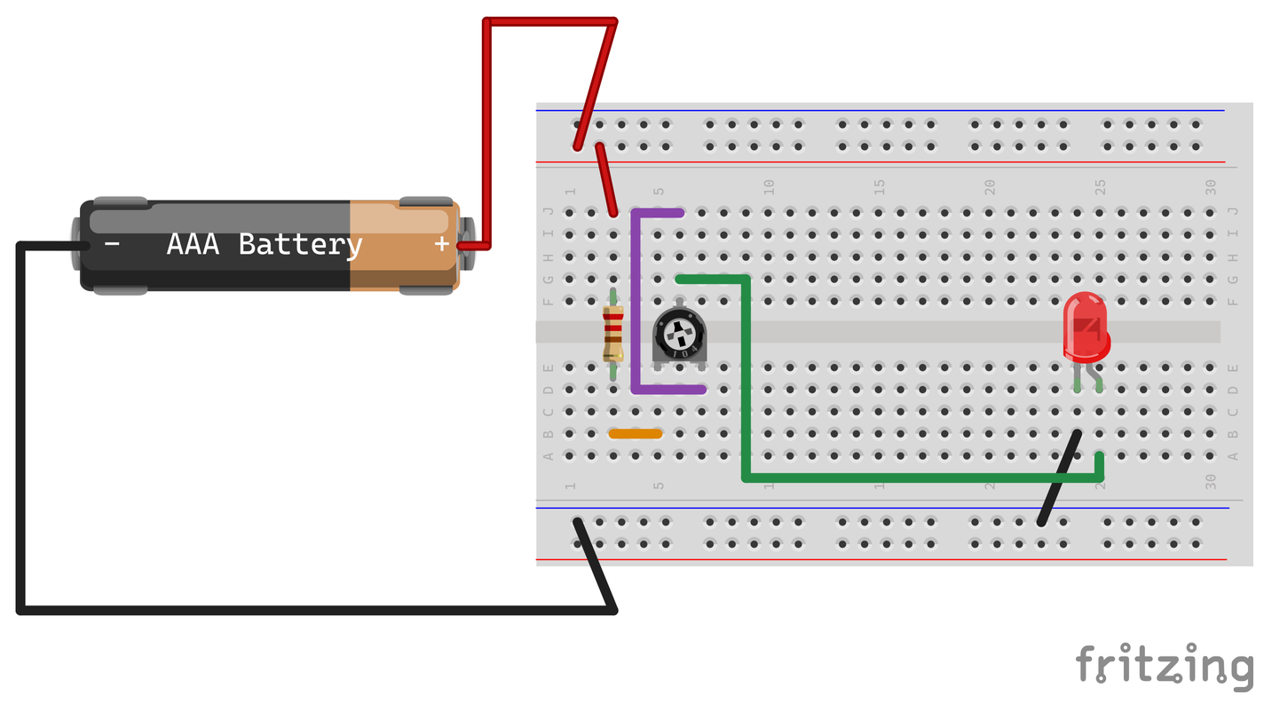
LAB 2 STEP 3 OF 6 BREADBOARD CHECK
7 / 27
Separate jumpers at the wiper
ORANGE: RESISTOR TO A
Join the resistor output to end A. The model uses B3–B5.
PURPLE: WIPER X TO B
Join J6 to D7. This connects the wiper strip to the unused end B.
GREEN: WIPER X TO LED
Use a separate jumper from G6 to A25, the LED anode strip.
Model coordinates only. F6–J6 share one strip. A5–E5 and A7–E7 are separate strips.
CHECK
The two jumpers meet through the wiper strip on the board. No wire splice is needed.
DC Theory Chapter 4 Student labs 3 V pack (2×AAA) Slide 7 of 27
Notes:
Student Lab 2, step 2 of 4. Record predictions, measurements with units, and explanations on paper. Use your actual source voltage and measured component values.
Source: NJATC DC Theory, 3rd edition, ISBN 9781935941125, Chapter 4, pp. 93-95. Activities adapted to a nominal 3 V two-AAA pack and the classroom inventory.
Circuit image: hands-on-assets/lab2-red-led-rheostat-student.png, from native Fritzing 1.0.8 core parts. Models show electrical connections. Match the actual component pinout and meter jack labels. The holder artwork depicts one cell although the classroom source is two AAA cells.
Classroom source: ONE nominal 3 V battery pack containing TWO 1.5 V AAA cells in series. Use actual measured loaded voltage and component values for calculations. The one-cell breadboard artwork does not change the source voltage.

Slide 8
LAB 2 STEP 4 OF 6 SCHEMATIC FIRST
8 / 27
LED circuit build and test
BUILD WITH POWER OFF
5 kΩ pot
Connect positive to 220 Ω, then pot end A. Connect wiper X to the LED anode, cathode to negative.
R1
220 Ω
B
A
CHECK THE PATH
+
anode
Keep the X-to-B link and fixed 220 Ω resistor. Confirm LED polarity and ask for a check.
B1
3 V
2×AAA
X
−
cathode
RED LED
X–B jumper
POWER AND TEST
Use the two-AAA pack. Turn the pot through your marked settings and observe the LED.
Schematic first. Try the connections before opening the next breadboard view.
CHECK
Match your real pot and LED pinouts. Keep the 220 Ω resistor in series at every setting.
DC Theory Chapter 4 Student labs 3 V pack (2×AAA) Slide 8 of 27
Notes:
Student Lab 2, step 3 of 4. Record predictions, measurements with units, and explanations on paper. Use your actual source voltage and measured component values.
Source: NJATC DC Theory, 3rd edition, ISBN 9781935941125, Chapter 4, pp. 93-95. Activities adapted to a nominal 3 V two-AAA pack and the classroom inventory.
Circuit image: hands-on-assets/lab2-red-led-rheostat-student.png, from native Fritzing 1.0.8 core parts. Models show electrical connections. Match the actual component pinout and meter jack labels. The holder artwork depicts one cell although the classroom source is two AAA cells.
Classroom source: ONE nominal 3 V battery pack containing TWO 1.5 V AAA cells in series. Use actual measured loaded voltage and component values for calculations. The one-cell breadboard artwork does not change the source voltage. This editable wiring schematic precedes the matching physical breadboard view. Attempt the circuit with power off, then compare the next slide. A is a current meter in series, V is a voltmeter across two points, Ω is an unpowered resistance measurement. Symbols identify electrical connectivity, not physical terminal locations.

Slide 9
LAB 2 STEP 5 OF 6 BREADBOARD CHECK
9 / 27
LED circuit build and test
BUILD WITH POWER OFF
Connect positive to 220 Ω, then pot end A. Connect wiper X to the LED anode, cathode to negative.
CHECK THE PATH
Keep the purple X-to-B link and fixed 220 Ω resistor. Confirm LED polarity and ask for a wiring check.
POWER AND TEST
Use the two-AAA pack. Turn the pot through your marked settings and observe the LED.
Use the actual two-AAA pack, about 3 V. The holder graphic looks like one cell.
CHECK
Match your real pot and LED pinouts. Keep the 220 Ω resistor in series at every setting.
DC Theory Chapter 4 Student labs 3 V pack (2×AAA) Slide 9 of 27
Notes:
Student Lab 2, step 3 of 4. Record predictions, measurements with units, and explanations on paper. Use your actual source voltage and measured component values.
Source: NJATC DC Theory, 3rd edition, ISBN 9781935941125, Chapter 4, pp. 93-95. Activities adapted to a nominal 3 V two-AAA pack and the classroom inventory.
Circuit image: hands-on-assets/lab2-red-led-rheostat-student.png, from native Fritzing 1.0.8 core parts. Models show electrical connections. Match the actual component pinout and meter jack labels. The holder artwork depicts one cell although the classroom source is two AAA cells.
Classroom source: ONE nominal 3 V battery pack containing TWO 1.5 V AAA cells in series. Use actual measured loaded voltage and component values for calculations. The one-cell breadboard artwork does not change the source voltage.

Slide 10
LAB 2 STEP 6 OF 6
10 / 27
LED results
Use your isolated pot readings from Lab 2. Measure DC volts across the fixed resistor.
SETTING | POT A–X (Ω) | BRIGHTNESS | FIXED R (V) | CURRENT (mA)
Low | Your reading | Describe | Your reading | Calculate
Middle | Your reading | Describe | Your reading | Calculate
High | Your reading | Describe | Your reading | Calculate
CHECK
I(A) = V(fixed resistor) ÷ R(measured). Multiply by 1000 for mA. Which setting was brightest?
DC Theory Chapter 4 Student labs 3 V pack (2×AAA) Slide 10 of 27
Notes:
Student Lab 2, step 4 of 4. Record predictions, measurements with units, and explanations on paper. Use your actual source voltage and measured component values.
Source: NJATC DC Theory, 3rd edition, ISBN 9781935941125, Chapter 4, pp. 93-95. Activities adapted to a nominal 3 V two-AAA pack and the classroom inventory.
Classroom source: ONE nominal 3 V battery pack containing TWO 1.5 V AAA cells in series. Use actual measured loaded voltage and component values for calculations. The one-cell breadboard artwork does not change the source voltage.

Slide 11
LAB 3 STEP 1 OF 5 SCHEMATIC FIRST
11 / 27
Three resistors in one current path
BUILD WITH POWER OFF
Remove the LED and pot. Connect the three 220 Ω resistors in series as shown.
R1
220 Ω
R2
220 Ω
R3
220 Ω
MEASURE THE SOURCE
+
After a wiring check, select DC volts. Measure across the pack and record its actual voltage.
B1
3 V
2×AAA
−
PREDICT CURRENT
Add your measured resistor values. Calculate I(A) = source volts ÷ total Ω. Convert to mA.
Schematic first. Try the connections before opening the next breadboard view.
CHECK
Use only the two-AAA pack. Disconnect it before changing wires or meter input jacks.
DC Theory Chapter 4 Student labs 3 V pack (2×AAA) Slide 11 of 27
Notes:
Student Lab 3, step 1 of 3. Record predictions, measurements with units, and explanations on paper. Use your actual source voltage and measured component values.
Source: NJATC DC Theory, 3rd edition, ISBN 9781935941125, Chapter 4, pp. 95-99. Activities adapted to a nominal 3 V two-AAA pack and the classroom inventory.
Circuit image: hands-on-assets/lab3-three-series-resistors.png, from native Fritzing 1.0.8 core parts. Models show electrical connections. Match the actual component pinout and meter jack labels. The holder artwork depicts one cell although the classroom source is two AAA cells.
Classroom source: ONE nominal 3 V battery pack containing TWO 1.5 V AAA cells in series. Use actual measured loaded voltage and component values for calculations. The one-cell breadboard artwork does not change the source voltage. This editable wiring schematic precedes the matching physical breadboard view. Attempt the circuit with power off, then compare the next slide. A is a current meter in series, V is a voltmeter across two points, Ω is an unpowered resistance measurement. Symbols identify electrical connectivity, not physical terminal locations.

Slide 12
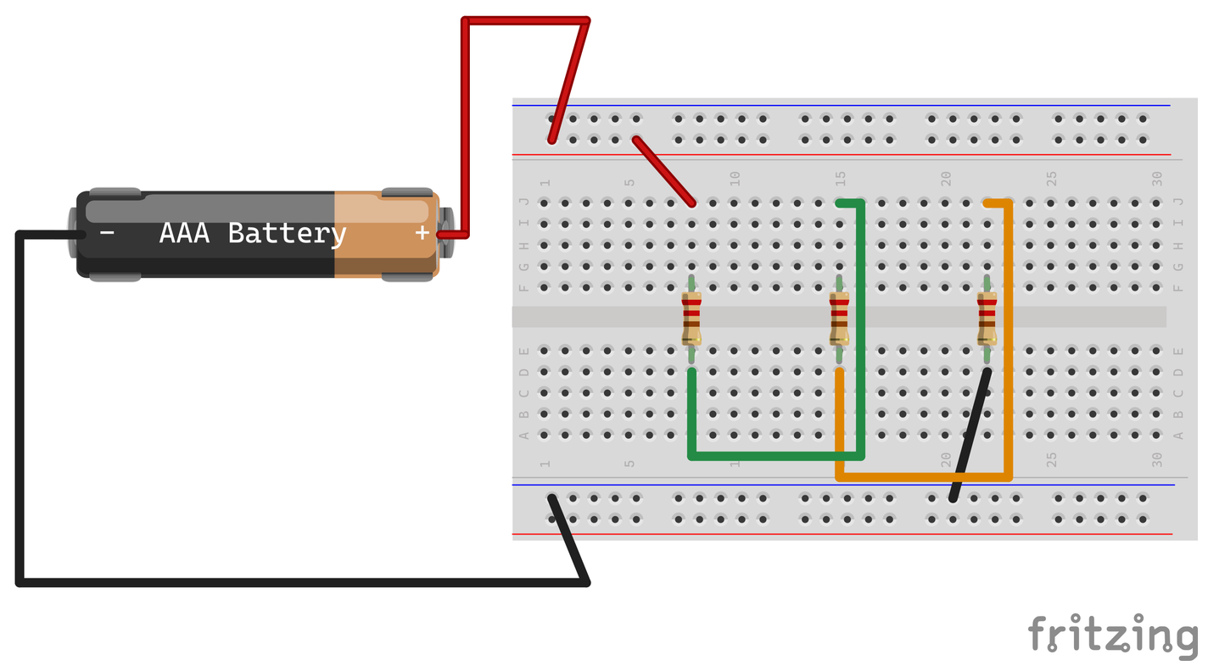
LAB 3 STEP 2 OF 5 BREADBOARD CHECK
12 / 27
Three resistors in one current path
BUILD WITH POWER OFF
Remove the LED and pot. Connect the three 220 Ω resistors in series as shown.
MEASURE THE SOURCE
After a wiring check, select DC volts. Measure across the pack and record its actual voltage.
PREDICT CURRENT
Add your measured resistor values. Calculate I(A) = source volts ÷ total Ω. Convert to mA.
R1 is left, R2 middle, R3 right. Keep this circuit for Labs 4–6.
CHECK
Use only the two-AAA pack. Disconnect it before changing wires or meter input jacks.
DC Theory Chapter 4 Student labs 3 V pack (2×AAA) Slide 12 of 27
Notes:
Student Lab 3, step 1 of 3. Record predictions, measurements with units, and explanations on paper. Use your actual source voltage and measured component values.
Source: NJATC DC Theory, 3rd edition, ISBN 9781935941125, Chapter 4, pp. 95-99. Activities adapted to a nominal 3 V two-AAA pack and the classroom inventory.
Circuit image: hands-on-assets/lab3-three-series-resistors.png, from native Fritzing 1.0.8 core parts. Models show electrical connections. Match the actual component pinout and meter jack labels. The holder artwork depicts one cell although the classroom source is two AAA cells.
Classroom source: ONE nominal 3 V battery pack containing TWO 1.5 V AAA cells in series. Use actual measured loaded voltage and component values for calculations. The one-cell breadboard artwork does not change the source voltage.

Slide 13
LAB 3 STEP 3 OF 5 SCHEMATIC FIRST
13 / 27
Series current measurement
DISCONNECT THE PACK
Remove the black R3 return jumper to create one gap.
R1
220 Ω
R2
220 Ω
R3
220 Ω
INSERT THE METER
+
Select DC current. Red to R3, COM to the negative rail. Ask for a wiring check.
B1
3 V
2×AAA
−
A
+
MEASURE AND RESTORE
COM
Reconnect and record mA. Disconnect, remove the meter and restore the return jumper.
Schematic first. Try the connections before opening the next breadboard view.
CHECK
Use a fused input and suitable range. Never place an ammeter across the pack.
DC Theory Chapter 4 Student labs 3 V pack (2×AAA) Slide 13 of 27
Notes:
Student Lab 3, step 2 of 3. Record predictions, measurements with units, and explanations on paper. Use your actual source voltage and measured component values.
Source: NJATC DC Theory, 3rd edition, ISBN 9781935941125, Chapter 4, pp. 95-99. Activities adapted to a nominal 3 V two-AAA pack and the classroom inventory.
Circuit image: hands-on-assets/lab3-current-meter.png, from native Fritzing 1.0.8 core parts. Models show electrical connections. Match the actual component pinout and meter jack labels. The holder artwork depicts one cell although the classroom source is two AAA cells.
Classroom source: ONE nominal 3 V battery pack containing TWO 1.5 V AAA cells in series. Use actual measured loaded voltage and component values for calculations. The one-cell breadboard artwork does not change the source voltage. This editable wiring schematic precedes the matching physical breadboard view. Attempt the circuit with power off, then compare the next slide. A is a current meter in series, V is a voltmeter across two points, Ω is an unpowered resistance measurement. Symbols identify electrical connectivity, not physical terminal locations.

Slide 14
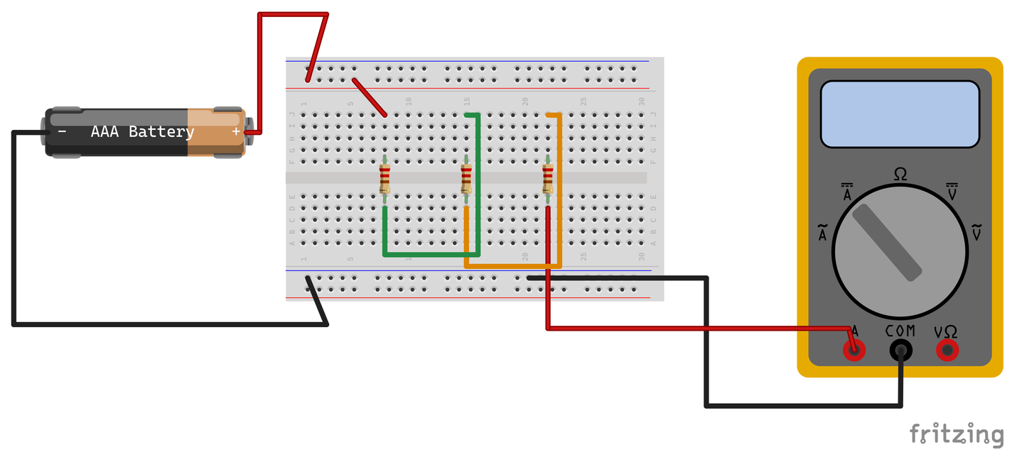
LAB 3 STEP 4 OF 5 BREADBOARD CHECK
14 / 27
Series current measurement
DISCONNECT THE PACK
Remove the black R3 return jumper to create one gap.
INSERT THE METER
Select DC current. Red to R3, COM to the negative rail. Ask for a wiring check.
MEASURE AND RESTORE
Reconnect and record mA. Disconnect, remove the meter and restore the return jumper.
The current meter replaces the removed jumper. Follow your meter’s jack labels.
CHECK
Use a fused input and suitable range. Never place an ammeter across the pack.
DC Theory Chapter 4 Student labs 3 V pack (2×AAA) Slide 14 of 27
Notes:
Student Lab 3, step 2 of 3. Record predictions, measurements with units, and explanations on paper. Use your actual source voltage and measured component values.
Source: NJATC DC Theory, 3rd edition, ISBN 9781935941125, Chapter 4, pp. 95-99. Activities adapted to a nominal 3 V two-AAA pack and the classroom inventory.
Circuit image: hands-on-assets/lab3-current-meter.png, from native Fritzing 1.0.8 core parts. Models show electrical connections. Match the actual component pinout and meter jack labels. The holder artwork depicts one cell although the classroom source is two AAA cells.
Classroom source: ONE nominal 3 V battery pack containing TWO 1.5 V AAA cells in series. Use actual measured loaded voltage and component values for calculations. The one-cell breadboard artwork does not change the source voltage.

Slide 15
LAB 3 STEP 5 OF 5
15 / 27
Current at three positions
Open only the listed jumper. Put red toward source positive and COM toward negative.
POSITION | JUMPER TO REPLACE | PREDICT (mA) | MEASURE (mA)
Before R1 | Red feed to R1 | Your value | Your reading
R1 to R2 | Complete green link | Your value | Your reading
After R3 | Black return from R3 | Your value | Your reading
CHECK
Disconnect before every move. Restore each jumper. Finish with power off and the red lead in V/Ω.
DC Theory Chapter 4 Student labs 3 V pack (2×AAA) Slide 15 of 27
Notes:
Student Lab 3, step 3 of 3. Record predictions, measurements with units, and explanations on paper. Use your actual source voltage and measured component values.
Source: NJATC DC Theory, 3rd edition, ISBN 9781935941125, Chapter 4, pp. 95-99. Activities adapted to a nominal 3 V two-AAA pack and the classroom inventory.
Classroom source: ONE nominal 3 V battery pack containing TWO 1.5 V AAA cells in series. Use actual measured loaded voltage and component values for calculations. The one-cell breadboard artwork does not change the source voltage.

Slide 16
LAB 4 STEP 1 OF 4 SCHEMATIC FIRST
16 / 27
Voltage across each resistor
RESTORE THE PATH
Power off. Restore all jumpers. Put leads in V/Ω and COM, then select DC volts.
R1
220 Ω
R2
220 Ω
R3
220 Ω
MEASURE THE DROPS
+
+
Power the circuit. Put red on each resistor’s input side and COM on its output side.
B1
3 V
2×AAA
V
COM
−
RECORD AND COMPARE
Record V1, V2 and V3. Add them and compare with the source voltage measured in Lab 3.
Schematic first. Try the connections before opening the next breadboard view.
CHECK
Record source V, V1, V2, V3 and their sum. Keep probe tips from bridging adjacent strips.
DC Theory Chapter 4 Student labs 3 V pack (2×AAA) Slide 16 of 27
Notes:
Student Lab 4, step 1 of 3. Record predictions, measurements with units, and explanations on paper. Use your actual source voltage and measured component values.
Source: NJATC DC Theory, 3rd edition, ISBN 9781935941125, Chapter 4, pp. 99-100,103-104. Activities adapted to a nominal 3 V two-AAA pack and the classroom inventory.
Circuit image: hands-on-assets/lab4-voltage-across-r1.png, from native Fritzing 1.0.8 core parts. Models show electrical connections. Match the actual component pinout and meter jack labels. The holder artwork depicts one cell although the classroom source is two AAA cells.
Classroom source: ONE nominal 3 V battery pack containing TWO 1.5 V AAA cells in series. Use actual measured loaded voltage and component values for calculations. The one-cell breadboard artwork does not change the source voltage. This editable wiring schematic precedes the matching physical breadboard view. Attempt the circuit with power off, then compare the next slide. A is a current meter in series, V is a voltmeter across two points, Ω is an unpowered resistance measurement. Symbols identify electrical connectivity, not physical terminal locations.

Slide 17
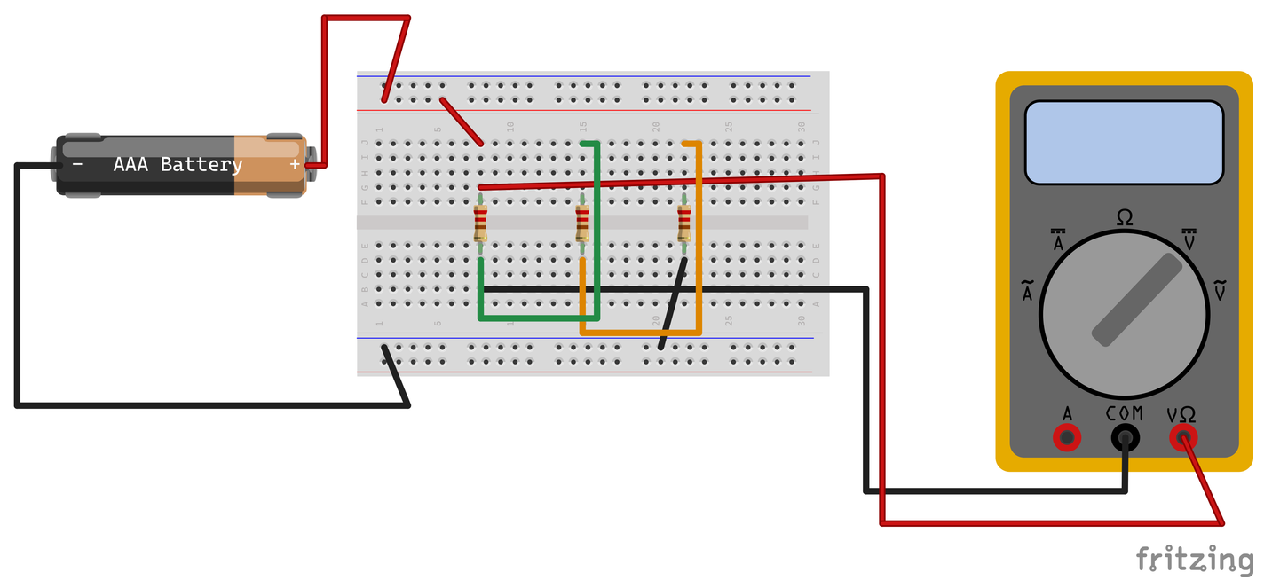
LAB 4 STEP 2 OF 4 BREADBOARD CHECK
17 / 27
Voltage across each resistor
RESTORE THE PATH
Power off. Restore all jumpers. Put leads in V/Ω and COM, then select DC volts.
MEASURE THE DROPS
Power the circuit. Put red on each resistor’s input side and COM on its output side.
RECORD AND COMPARE
Record V1, V2 and V3. Add them and compare with the source voltage measured in Lab 3.
The probes span R1. Keep the ordinary current path complete for voltage tests.
CHECK
Record source V, V1, V2, V3 and their sum. Keep probe tips from bridging adjacent strips.
DC Theory Chapter 4 Student labs 3 V pack (2×AAA) Slide 17 of 27
Notes:
Student Lab 4, step 1 of 3. Record predictions, measurements with units, and explanations on paper. Use your actual source voltage and measured component values.
Source: NJATC DC Theory, 3rd edition, ISBN 9781935941125, Chapter 4, pp. 99-100,103-104. Activities adapted to a nominal 3 V two-AAA pack and the classroom inventory.
Circuit image: hands-on-assets/lab4-voltage-across-r1.png, from native Fritzing 1.0.8 core parts. Models show electrical connections. Match the actual component pinout and meter jack labels. The holder artwork depicts one cell although the classroom source is two AAA cells.
Classroom source: ONE nominal 3 V battery pack containing TWO 1.5 V AAA cells in series. Use actual measured loaded voltage and component values for calculations. The one-cell breadboard artwork does not change the source voltage.

Slide 18
LAB 4 STEP 3 OF 4
18 / 27
Voltage across unequal groups
Keep the same circuit. Predict from your measured resistance totals.
GROUP | RESISTANCE (Ω) | PREDICTED VOLTS
A: R1 | Use your R1 | E × R1 ÷ Rtotal
B: R2 + R3 | Add your R2 + R3 | E × (R2 + R3) ÷ Rtotal
A and B together | Add all three | Use measured source V
CHECK
For group B, span R2’s input to R3’s output in DC volts. Record the measured group voltage.
DC Theory Chapter 4 Student labs 3 V pack (2×AAA) Slide 18 of 27
Notes:
Student Lab 4, step 2 of 3. Record predictions, measurements with units, and explanations on paper. Use your actual source voltage and measured component values.
Source: NJATC DC Theory, 3rd edition, ISBN 9781935941125, Chapter 4, pp. 99-100,103-104. Activities adapted to a nominal 3 V two-AAA pack and the classroom inventory.
Classroom source: ONE nominal 3 V battery pack containing TWO 1.5 V AAA cells in series. Use actual measured loaded voltage and component values for calculations. The one-cell breadboard artwork does not change the source voltage.

Slide 19
LAB 4 STEP 4 OF 4
19 / 27
Voltage results
Copy the table. Compare each prediction with your actual reading.
MEASURE ACROSS | PREDICTED (V) | MEASURED (V)
R1 | Your calculation | Your reading
R2 + R3 | Your calculation | Your reading
All three resistors | Your calculation | Your reading
CHECK
Does V(R1) + V(R2 + R3) match the source? Which group receives more voltage, and why?
DC Theory Chapter 4 Student labs 3 V pack (2×AAA) Slide 19 of 27
Notes:
Student Lab 4, step 3 of 3. Record predictions, measurements with units, and explanations on paper. Use your actual source voltage and measured component values.
Source: NJATC DC Theory, 3rd edition, ISBN 9781935941125, Chapter 4, pp. 99-100,103-104. Activities adapted to a nominal 3 V two-AAA pack and the classroom inventory.
Classroom source: ONE nominal 3 V battery pack containing TWO 1.5 V AAA cells in series. Use actual measured loaded voltage and component values for calculations. The one-cell breadboard artwork does not change the source voltage.

Slide 20
LAB 5 STEP 1 OF 3
20 / 27
Resistance from voltage and current
USE YOUR RECORDED VALUES
Treat R3 as unknown. Use its measured V3 and the circuit current from Lab 3.
CALCULATE AND RECORD
Convert mA to A. Calculate R3 = V3 ÷ I. Record the result in Ω.
VERIFY WITH POWER OFF
Disconnect the pack. Isolate R3 and measure Ω. Record the difference, then restore R3 with power off.
CHECK
Use the voltage across R3 for this calculation. Record calculated Ω and isolated measured Ω.
DC Theory Chapter 4 Student labs 3 V pack (2×AAA) Slide 20 of 27
Notes:
Student Lab 5, step 1 of 3. Record predictions, measurements with units, and explanations on paper. Use your actual source voltage and measured component values.
Source: NJATC DC Theory, 3rd edition, ISBN 9781935941125, Chapter 4, pp. 100-103. Activities adapted to a nominal 3 V two-AAA pack and the classroom inventory.
Classroom source: ONE nominal 3 V battery pack containing TWO 1.5 V AAA cells in series. Use actual measured loaded voltage and component values for calculations. The one-cell breadboard artwork does not change the source voltage.

Slide 21
LAB 5 STEP 2 OF 3
21 / 27
Power from your recorded readings
Use your Lab 3 current in amperes. Divide mA by 1000 before calculating watts.
LOAD | VOLTAGE (V) | POWER = V × I (W)
R1 | Your V1 | Your calculation
R2 | Your V2 | Your calculation
R3 | Your V3 | Your calculation
Source / total | Your source V | Your calculation
CHECK
Add P1 + P2 + P3. Compare that sum with source voltage × circuit current. Explain any difference.
DC Theory Chapter 4 Student labs 3 V pack (2×AAA) Slide 21 of 27
Notes:
Student Lab 5, step 2 of 3. Record predictions, measurements with units, and explanations on paper. Use your actual source voltage and measured component values.
Source: NJATC DC Theory, 3rd edition, ISBN 9781935941125, Chapter 4, pp. 100-103. Activities adapted to a nominal 3 V two-AAA pack and the classroom inventory.
Classroom source: ONE nominal 3 V battery pack containing TWO 1.5 V AAA cells in series. Use actual measured loaded voltage and component values for calculations. The one-cell breadboard artwork does not change the source voltage.

Slide 22
LAB 5 STEP 3 OF 3
22 / 27
Power and rating results
Ask the instructor for the verified resistor power rating. Record it in watts.
RESISTOR | CALCULATED (W) | RATING (W) | BELOW RATING?
R1 | Your calculation | Verified value | Yes / No
R2 | Your calculation | Verified value | Yes / No
R3 | Your calculation | Verified value | Yes / No
CHECK
Compare calculated watts with verified ratings. Use only the 3 V pack. Keep it disconnected.
DC Theory Chapter 4 Student labs 3 V pack (2×AAA) Slide 22 of 27
Notes:
Student Lab 5, step 3 of 3. Record predictions, measurements with units, and explanations on paper. Use your actual source voltage and measured component values.
Source: NJATC DC Theory, 3rd edition, ISBN 9781935941125, Chapter 4, pp. 100-103. Activities adapted to a nominal 3 V two-AAA pack and the classroom inventory.
Classroom source: ONE nominal 3 V battery pack containing TWO 1.5 V AAA cells in series. Use actual measured loaded voltage and component values for calculations. The one-cell breadboard artwork does not change the source voltage.

Slide 23
LAB 6 STEP 1 OF 5 SCHEMATIC FIRST
23 / 27
Voltage at an open link
CREATE ONE OPEN
Disconnect the pack. Remove the complete green link between R1 and R2. Predict current.
R1
220 Ω
OPEN
R2
220 Ω
R3
220 Ω
MEASURE IN DC VOLTS
+
+
Use V/Ω and COM. After a check, power the circuit. Measure across the opening as shown.
B1
3 V
2×AAA
V
COM
−
RECORD
Record the gap voltage. Then span R2 and record its voltage. Disconnect the pack.
Schematic first. Try the connections before opening the next breadboard view.
CHECK
Predict open-circuit current only. An ammeter across the gap would reconnect the path.
DC Theory Chapter 4 Student labs 3 V pack (2×AAA) Slide 23 of 27
Notes:
Student Lab 6, step 1 of 3. Record predictions, measurements with units, and explanations on paper. Use your actual source voltage and measured component values.
Source: NJATC DC Theory, 3rd edition, ISBN 9781935941125, Chapter 4, pp. 95-96,111. Activities adapted to a nominal 3 V two-AAA pack and the classroom inventory.
Circuit image: hands-on-assets/lab6-open-circuit.png, from native Fritzing 1.0.8 core parts. Models show electrical connections. Match the actual component pinout and meter jack labels. The holder artwork depicts one cell although the classroom source is two AAA cells.
Classroom source: ONE nominal 3 V battery pack containing TWO 1.5 V AAA cells in series. Use actual measured loaded voltage and component values for calculations. The one-cell breadboard artwork does not change the source voltage. This editable wiring schematic precedes the matching physical breadboard view. Attempt the circuit with power off, then compare the next slide. A is a current meter in series, V is a voltmeter across two points, Ω is an unpowered resistance measurement. Symbols identify electrical connectivity, not physical terminal locations.

Slide 24
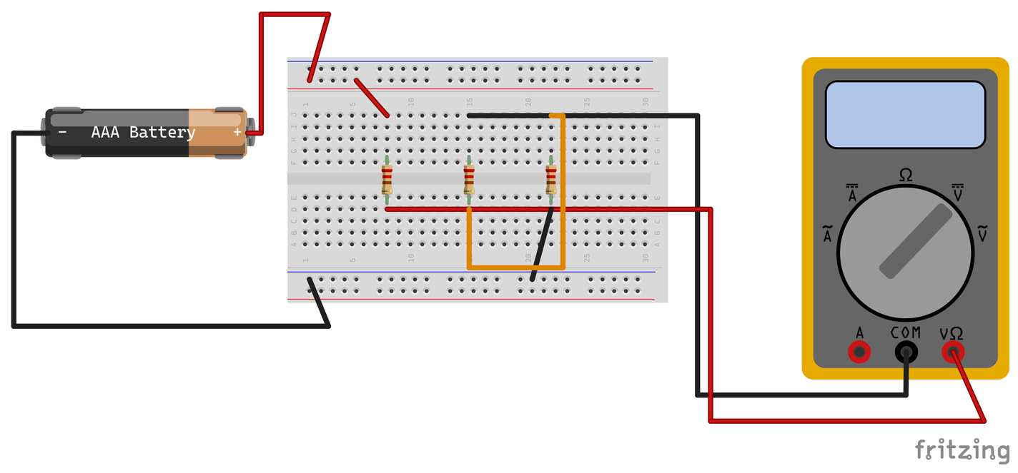
LAB 6 STEP 2 OF 5 BREADBOARD CHECK
24 / 27
Voltage at an open link
CREATE ONE OPEN
Disconnect the pack. Remove the complete green link between R1 and R2. Predict current.
MEASURE IN DC VOLTS
Use V/Ω and COM. After a check, power the circuit. Measure across the opening as shown.
RECORD
Record the gap voltage. Then span R2 and record its voltage. Disconnect the pack.
Across the gap: red on the R1 side, COM on the R2 side. Other links remain intact.
CHECK
Predict open-circuit current only. An ammeter across the gap would reconnect the path.
DC Theory Chapter 4 Student labs 3 V pack (2×AAA) Slide 24 of 27
Notes:
Student Lab 6, step 1 of 3. Record predictions, measurements with units, and explanations on paper. Use your actual source voltage and measured component values.
Source: NJATC DC Theory, 3rd edition, ISBN 9781935941125, Chapter 4, pp. 95-96,111. Activities adapted to a nominal 3 V two-AAA pack and the classroom inventory.
Circuit image: hands-on-assets/lab6-open-circuit.png, from native Fritzing 1.0.8 core parts. Models show electrical connections. Match the actual component pinout and meter jack labels. The holder artwork depicts one cell although the classroom source is two AAA cells.
Classroom source: ONE nominal 3 V battery pack containing TWO 1.5 V AAA cells in series. Use actual measured loaded voltage and component values for calculations. The one-cell breadboard artwork does not change the source voltage.

Slide 25
LAB 6 STEP 3 OF 5 SCHEMATIC FIRST
25 / 27
A bypass around R2
RESTORE WITH POWER OFF
Keep the pack disconnected. Restore the green R1-to-R2 link.
R1
220 Ω
R2
220 Ω
R3
220 Ω
BYPASS R2 ONLY
+
Join R2’s input and output strips with the purple jumper. Keep R1 and R3 in series. Ask for a check.
B1
3 V
2×AAA
−
R2 bypass
TEST AND RECORD
Predict current with R1 + R3. Reconnect in DC volts and record the drop across R2.
Schematic first. Try the connections before opening the next breadboard view.
CHECK
Never bridge the battery rails. Disconnect the pack before removing the bypass.
DC Theory Chapter 4 Student labs 3 V pack (2×AAA) Slide 25 of 27
Notes:
Student Lab 6, step 2 of 3. Record predictions, measurements with units, and explanations on paper. Use your actual source voltage and measured component values.
Source: NJATC DC Theory, 3rd edition, ISBN 9781935941125, Chapter 4, pp. 95-96,111. Activities adapted to a nominal 3 V two-AAA pack and the classroom inventory.
Circuit image: hands-on-assets/lab6-r2-bypass.png, from native Fritzing 1.0.8 core parts. Models show electrical connections. Match the actual component pinout and meter jack labels. The holder artwork depicts one cell although the classroom source is two AAA cells.
Classroom source: ONE nominal 3 V battery pack containing TWO 1.5 V AAA cells in series. Use actual measured loaded voltage and component values for calculations. The one-cell breadboard artwork does not change the source voltage. This editable wiring schematic precedes the matching physical breadboard view. Attempt the circuit with power off, then compare the next slide. A is a current meter in series, V is a voltmeter across two points, Ω is an unpowered resistance measurement. Symbols identify electrical connectivity, not physical terminal locations.

Slide 26
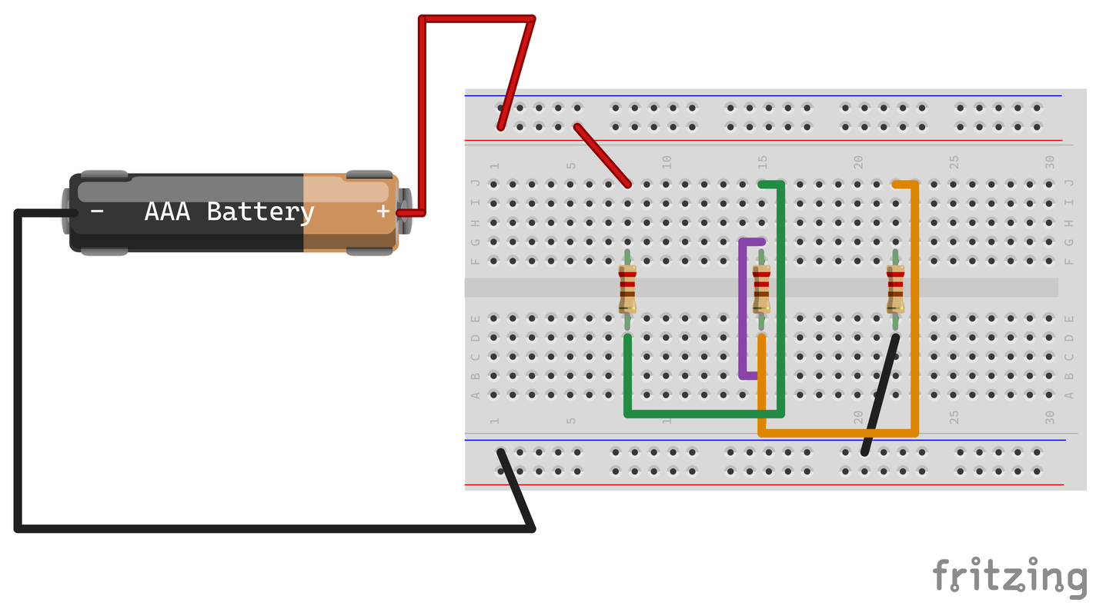
LAB 6 STEP 4 OF 5 BREADBOARD CHECK
26 / 27
A bypass around R2
RESTORE WITH POWER OFF
Keep the pack disconnected. Restore the green R1-to-R2 link.
BYPASS R2 ONLY
Join R2’s input and output strips with the purple jumper. Keep R1 and R3 in series. Ask for a check.
TEST AND RECORD
Predict current with R1 + R3. Reconnect in DC volts and record the drop across R2.
The purple jumper joins R2’s two strips. R1 and R3 remain in the current path.
CHECK
Never bridge the battery rails. Disconnect the pack before removing the bypass.
DC Theory Chapter 4 Student labs 3 V pack (2×AAA) Slide 26 of 27
Notes:
Student Lab 6, step 2 of 3. Record predictions, measurements with units, and explanations on paper. Use your actual source voltage and measured component values.
Source: NJATC DC Theory, 3rd edition, ISBN 9781935941125, Chapter 4, pp. 95-96,111. Activities adapted to a nominal 3 V two-AAA pack and the classroom inventory.
Circuit image: hands-on-assets/lab6-r2-bypass.png, from native Fritzing 1.0.8 core parts. Models show electrical connections. Match the actual component pinout and meter jack labels. The holder artwork depicts one cell although the classroom source is two AAA cells.
Classroom source: ONE nominal 3 V battery pack containing TWO 1.5 V AAA cells in series. Use actual measured loaded voltage and component values for calculations. The one-cell breadboard artwork does not change the source voltage.

Slide 27
LAB 6 STEP 5 OF 5
27 / 27
Fault results and circuit reset
Use Lab 4 for normal R2 volts. Compare it with the open-link and bypass readings.
CONDITION | PREDICT I (mA) | R2 VOLTS | EXPLAIN PATH
Normal circuit | Your calculation | Lab 4 reading | Your explanation
Open R1–R2 link | Your prediction | Your reading | Your explanation
R2 bypassed | Your calculation | Your reading | Your explanation
CHECK
Finish: pack disconnected, bypass removed, normal links restored, red lead in V/Ω.
DC Theory Chapter 4 Student labs 3 V pack (2×AAA) Slide 27 of 27
Notes:
Student Lab 6, step 3 of 3. Record predictions, measurements with units, and explanations on paper. Use your actual source voltage and measured component values.
Source: NJATC DC Theory, 3rd edition, ISBN 9781935941125, Chapter 4, pp. 95-96,111. Activities adapted to a nominal 3 V two-AAA pack and the classroom inventory.
Classroom source: ONE nominal 3 V battery pack containing TWO 1.5 V AAA cells in series. Use actual measured loaded voltage and component values for calculations. The one-cell breadboard artwork does not change the source voltage.

